Slide 1
Behavioral Wellness: Recruit Firefighter Training
Based on the Yellow Ribbon Report developed by the IAFC Volunteer Combination Officers Section
Notes:
Instructor Notes:
See it.
Hear it.
Say it.
Write it.
Reinforce the lessons in this program.
Discuss briefly the history of the Yellow Ribbon Report, how VCOS developed it (workshop November 2016 with compiling, editing, authors from fire service, chaplaincy, clinician, and an academic)
YRR released at FRI in July 2017—positive reaction, but chiefs wanted more on HOW to develop and implement behavioral health programs for their departments.
Discuss how that led to the development of this training, mention focus group November 2017 (specifics on next slide)

Slide 2
Behavioral Wellness Operations Training
Chief Donna Black
Duck, NC
Board Member
IAFC Rep.
Chief Jim Cook
Leesburg VA
Board Member
Chief Rich Cowger
MT
Vice Chair
Chief Al Yancey
IL
Board Member
Chief Jason Catatrombe
Board Member
Chief Ed Rush
NY
Board Member
Chief Ron Oettel
Board Member
Chief Tim Wall
Wallingford CT
Chair Emeritus
VCOS Board Members:
Chief Chuck Flynn
Suffield, CT
Chair
Chief Fred Windisch
Ponderosa TX
Treasurer
Chief Norvin Collins
Board Member

Slide 3
Behavioral Wellness: Awareness Level Training
Contributing Authors
John M. Buckman III
Elizabeth Anderson-Fletcher
Pat Kenny
Skip Straus
Notes:
These four people, a subset of the YRR authors, were tasked with developing education and training—content and delivery
Buckman—retired fire chief, ___-year career in the fire service
Kenney—fire chief, ____-year career in the fire service
Straus—chaplain of 20 years, 30-years as an EMT and paramedic, a volunteer FF
Anderson-Fletcher—faculty (research) at the University of Houston, volunteer FF.

Slide 4
Behavioral Wellness: Awareness Level Training
Introduction of Instructor(s)

Slide 5
Mission
To provide education and training to recruits/firefighters about behavioral wellness issues and the personal/professional impact:
Recruit/Firefighter
Officer
Chief
Notes:
Explain the levels of training and use comments from the report
Awareness - basic information about the issue / sandwich approach (both top-down and bottom-up)
Operations - programs and actions /
Technician - professional services integration
Chief Level - leadership responsibilities
Build the sandwich

Slide 6
Group Introductions
Who you are?
Service time?
Family?
Notes:
if you are doing this in a seminar/conference style presentation and students don’t know each other this would be an appropriate time for students to introduce themselves.

Slide 7
Training Objectives
The student shall be able to define:
Employee Assistance Program (EAP)
Describe the services associated with his/her department’s designated EAP (if department has one).
Critical Incident Stress Management (CISM)
Describe the components of a CISM program.
The student shall be able to identify:
potential triggers that positively/negatively impact behavioral wellness
Notes:
Employee Assistance Program (EAP)
Definition— “…an employee benefit program that assists employees with personal problems and/or work-related problems that may impact their job performance, health, mental and emotional well-being.” (Wikipedia)
What services do their departments’ EAPs provide?
Critical Incident Stress Management (CISM)
What is a CISM program?
What is CISD vs. CISM?
Emphasize that Behavioral Health and Wellness is just as important as physical Health and Wellness

Slide 8
Training Objectives
The student shall be able to identify his/her:
Role in managing personal behavioral wellness
Shared responsibility for behavioral wellness within the organization
Role in organizational culture change toward behavioral wellness
Responsibility to share emotional response following traumatic events
Awareness of training programs and other resources available regarding behavioral wellness
Notes:
The next few slides show the objectives of this training
The student shall be able to identify his/her role in managing behavioral health for themselves.
responsibility in behavioral health issues within their department or company.
identify the organizational culture toward behavioral health and wellness within their FD.
identify the safety culture within their FD.
identify the debriefing process for events within their FD (note—CISM on a subsequent slide)
identify the training programs available through their FD relative to behavioral health and wellness.
Note—also important to know if there is no training program; where to find the resources…

Slide 9
Training Objectives
The student shall be able to define:
Post Traumatic Stress Disorder (PTSD)
Know the symptoms of PTS.
Suicide Prevention
Know the actions to take related to preventing suicide.
Suicide Intervention
Know the actions to take related to suicide intervention.
Notes:
Emphasize removing “disorder” from the term
PTSD:
Post-traumatic stress disorder (PTSD) is a mental health condition that's triggered by a terrifying event — either experiencing it or witnessing it.
Symptoms may include flashbacks, nightmares and severe anxiety, as well as uncontrollable thoughts about the event.
Source: Mayo Clinic
Also mention Post-vention?
Interpersonal theory of suicide?

Slide 10
Training Objectives
The student shall know the statistics about behavioral wellness for firefighters.
Line of Duty Death (LODD) (2016) – 89*
Suicide (2016) – 132**
*United States Fire Administration
**Firefighter Behavioral Health Alliance
Notes:
In 2016, 89 firefighter deaths in the line of duty were recorded; 130 suicide deaths were recorded by FBHA.
In 2015, 135 firefighters died by suicide, and 89 lost their lives in the line of duty.
The number was a bit lower in 2014 – 114 suicides and 92 LODDs, but you can clearly see the trend.
LODD numbers are confirmed by the U.S. Fire Administration (USFA)
Suicide numbers are confirmed by the Firefighter Behavioral Health Alliance (FBHA).
Mention—while there is mandatory reporting of LODDs to NIOSH, there is no such mandate for suicides.
Additionally, FBHA is not getting all the numbers since reporting is voluntary.
Stigma
Death certificates not always list profession; and certainly not for volunteers
statistics and percentage of these causes.
Line of Duty Death (LODD)
Cardiac Deaths
Traumatic Deaths
Training Deaths
MVA

Slide 11
Signs, symptoms, and actions to protect...
Accept we can’t always deal with stress...
Behavioral health affected firefighters for years...
Acknowledge and accepting the mental and physical impact...
Impact stress brings to our family, children...
Page 8 Yellow Ribbon Report
Written by Chief John M. Buckman III
Notes:
Refer students to page 8 of the YRR
The issue of behavioral health has affected firefighters for many years without much notice. Acknowledging and accepting the mental and physical impact has only recently been recognized as having short and long-term consequence on the mental wellness of our brothers and sisters, which we in the public safety community are now beginning to admit. It is a duty of ourselves to accept we cannot always deal with the stress that life and public safety brings to bear upon. The impact stress brings to our family, children, friends, and colleagues can no longer be ignored. The use of drugs, alcohol and other stimulants to disguise the symptoms must be recognized and action taken. Mental wellness is a necessity for members of the response community on the signs, symptoms and actions necessary to protect ourselves form the stressors.
- Chief John M. Buckman III

Slide 12
Human Reactions
0 to 60 mph
Listen
Involve
Help Is Available
Accept
Talk
Education Programs
Cultural Change / Behavioral Health
12
Notes:
Page 16 / bottom paragraph
Page 27 organizational size up questions

Slide 13
Video provided by the National Volunteer Fire Council
Introduction to Behavioral Wellness Action Items
https://vimeo.com/280976161

Slide 14
As firefighters, you will…
witness the miracle of birth...
cry with your patients...
hold a baby in your arms as it takes it’s last breath...
be vomited upon...
Have cookies brought to the fire station...
control bleeding...
Receive a thank you card from a grateful resident...
say a short, silent prayer for a patient...
Have a kid come up to you and hug your leg...
comfort a father who held his dead son in his arms and grieved with the greatest sorrow...
Be promoted to an officer rank...
Carry valuables out of a house after putting the fire out...
Chief Gary Ludwig, Champaign, IL Fire Dept., author, excerpted from Blood, Sweat, Tears, and Prayers

Slide 15
Action Statement 1
During recruit school, emotional and behavioral health, as well as dealing with cumulative stress, must become integrated into the initial education.
Notes:
This awareness education program developed by the VCOS is designed to complete this action statement.

Slide 16
Share your life experiences.
Students are asked to write down an event in their life that had a positive or negative impact on them.
Exercise
Notes:
Pass out 3x5 cards
Ask students to write down an event that has had an impact on your mental wellness?
Collect 3x5 cards
Shuffle cards
Pass cards back out
Can’t get their own card.
Ask student to read one of the cards.as
Ask students to elaborate on one of the cards.
Ask students after their story what were some of their emotions?
Anger
Frustration
Incompetent
Devastation
Etc.

Slide 17
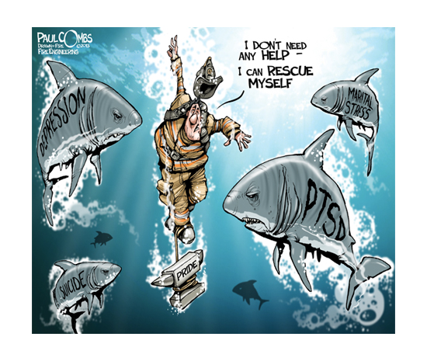
WHAT ARE THE CONSEQUENCES OF IGNORING BEHAVIORAL WELLNESS ISSUES?
“I asked for help. I begged my brothers and sisters for help. They ignored my plea. They weren’t behaving with malicious intent. They did not know the action to take to help me.”
Scott Gieselhart
Volunteer Firefighter, Suicide Attempt Survivor
Notes:
Why are our firefighters killing themselves? The short answer has to do with post-traumatic stress disorder (PTSD), but both the FBHA and the USFA say more factors are at play here. Family and money issues combined with the fact that firefighting/EMS is a high-stress profession. In fact, CareerCast.com just completed their annual survey of the most stressful careers in the nation. First, of course, are our enlisted active duty military personnel. Firefighting was number two. Number two! Ahead, even, of commercial airline pilots (the complete survey results can be found here). Career Cast factors in environment, life risk, and on the job hazards, among other things.

Slide 18
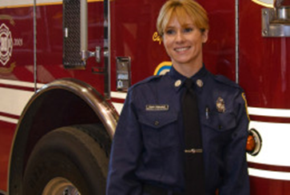
Firefighter Suicide Fairfax County, VA Fire-Rescue – April 13, 2016
Firefighter/Paramedic Nicole Mittendorf, age 31, was missing for six days before she was found in a park.
Her death was ruled suicide by hanging.
Cyber bullying and sexual harassment were alleged as possible contributing factors.
Notes:
Nicole Mittendorf, a 31-year-old firefighter/paramedic in Fairfax County, Virginia was missing for 6 days until her body was found in Shenandoah National Park; her death was ruled a suicide by hanging. After her death, reports emerged alleging cyber-bullying as a possible contributor
For chiefs’ training—Chief Richard Bowers lost his job over this—announced his retirement after a 41-year career February 18, 2016. Bowers’ retirement followed the resignation of Battalion Chief Kathleen Stanley, who headed Fairfax County Fire and Rescue Department's women's program; her resignation letter included details of at least half dozen allegations of sexual harassment.
Sources:
https://www.huffingtonpost.com/entry/nicole-mittendorf-firefighter-bullying_us_571e2959e4b0d0042da9b3d6
https://www.sebastiandaily.com/news/vero-beach/irc-rescue-firefighter-commits-suicide-after-facebook-post-1526/
https://ffxfirerescue.wordpress.com/2018/02/16/fire-chief-richard-bowers-announces-retirement/
Fairfax County fire chief announces retirement amid complaints about handling of sexual harassment
By Justin Jouvenal
February 16
Email the author
Fairfax County’s fire chief announced his retirement Friday, a little more than a week after county officials said they would investigate allegations that the department had failed to curb sexual harassment.
Richard R. Bowers Jr. has received high marks during his five-year tenure for the department’s firefighting work, but was dogged by complaints and a handful of lawsuits claiming that women were mistreated in the ranks. Bowers’s last day will be April 30.
The chief declined to comment, but county officials said Bowers offered to retire after a meeting this week with the county executive, who expressed frustration by the Board of Supervisors with the pace of progress in changing the culture of the department.
Still, Sharon Bulova (D), the chairwoman of the Fairfax County Board of Supervisors, praised Bowers’s work.
“Chief Bowers has been an outstanding chief in that he has been over the top with community outreach and engagement, and making improvements to some of the response issues the department has had,” Bulova said. “As we are looking for a new fire chief we will be looking for someone who has those skills and can deal with behavioral issues.”
Bowers was appointed chief in February 2013, following a 35-year career with the Montgomery County Fire and Rescue Service in Maryland. The department achieved a top-tier ranking for fire protection under his watch, created its first strategic plan and built and renovated stations.
[Female firefighter’s suicide is a ‘fire bell in the night’]
But the department was plunged into controversy in 2016 after firefighter Nicole Mittendorff committed suicide. Her family has not given a reason for her suicide, but sexist and sexually suggestive comments were made about her on a local Internet forum that appeared to come from people with knowledge of the department.
In the aftermath of Mittendorff’s death, other female firefighters came forward and some sued, alleging problems with sexual harassment in the department, a lack of leadership on the issue and problems with women advancing to higher ranks.
Bowers promised to change the culture of the department and instituted a number of changes, including revising policies for investigating sexual harassment claims and providing retraining on the issue.
County officials also commissioned a report analyzing the department’s culture that was released last year. A survey accompanying it found that nearly 40 percent of firefighters reported experiencing or witnessing harassment, bullying and discrimination. It also showed that some were dissatisfied with the department’s leadership.
Then last month, Battalion Chief Kathleen Stanley outlined fresh allegations in a scathing letter, submitting her resignation as interim director of the fire department’s women’s program. Department leaders disputed the claims.
[After a female firefighter’s suicide, the ugly sexual harassment was supposed to end. It hasn’t.]
“This position is for show with no legitimate authority, respect or value,” Stanley wrote in the letter. “Advice, advocacy and suggestions are humored, at best, and routinely dismissed.”
Stanley detailed a long list of complaints, including saying that a group of men received privileges that women did not, that a female firefighter was retaliated against after seeking an apology for sexual harassment and that the department’s “zero tolerance” policy for sexual harassment was not acted upon.
“I hope with the new administration we will get through all these problems,” Stanley said Friday. “We are a great department. We deserve a great leader.”
Bulova said the county will begin a wide-ranging search for Bowers’s replacement. It hopes to have a new chief in place by the time he retires at the end of April.

Slide 19
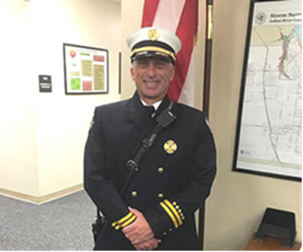
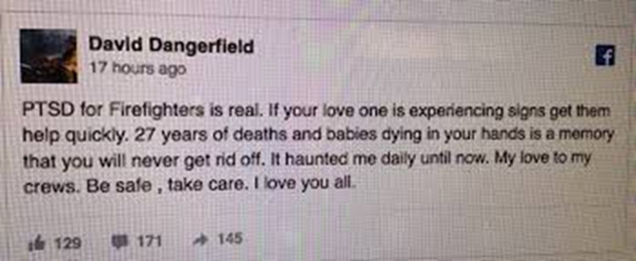
Fire Chief Suicide Indian River County, FL Fire-Rescue – October 15, 2016
Battalion Chief David Dangerfield died by suicide shortly after posting to Facebook.
“PTSD for Firefighters is real. If your love (sic) one is experiencing signs get them help quickly. 27 years of deaths and babies dying in your hands is a memory that you will never get rid off (sic). It haunted me daily until now. My love to my crews. Be safe, take care. I love you all.”
Notes:
David Dangerfield, a Florida Battalion Chief in Indian River County Fire Rescue, dies by suicide Saturday night shortly after writing a Facebook post about PTSD, according to the Sheriff’s Office.
Deputies found Battalion Chief David Dangerfield a short distance away in a wooded area off State Road 60 west of Interstate 95. They were responding to a call about the incident at about 10:30 p.m. Saturday, according to Sheriff’s spokesman Lt. Eric Flowers.
Flowers said Dangerfield drove his pickup on State Road 60 near I-95 and made a call to 911 to tell dispatchers where deputies could find his body.
Deputies drove to the scene and found Dangerfield dead from a self-inflicted gunshot wound, the Sheriff’s Office said.
IRC Emergency Management Director John King notified Dangerfield’s co-workers about his death, according to Assistant Chief Brian Burkeen.
“It is with great sadness I share with you the passing of Battalion Chief David Dangerfield this evening,” King wrote in the email to his staff. “Please keep Dave’s immediate and extended family in your thoughts and prayers.”
Just before his death, Dangerfield wrote this on his Facebook page:
“PTSD for Firefighters is real. If your love one is experiencing signs get them help quickly. 27 years of deaths and babies dying in your hands is a memory that you will never get rid off. It haunted me daily until now. My love to my crews. Be safe, take care. I love you all.”
Dangerfield was named Emergency Service Provider of the Year by the Treasure Coast Fire Chiefs’ Association in 2013.
Dangerfield was also a fire instructor at the Indian River State’s Fire Academy and a field training officer for the dive rescue team.
The veteran firefighter provided Thanksgiving Day meals through the Big Heart Brigade of Indian River County. Dangerfield also founded the annual Firefighters Chili and Salsa Cook-off, a charity fundraiser.
According to the IAFF (International Association of Firefighters):
“PTSD is a serious and chronic condition that can ruin the careers of fire fighters and paramedics, destroy families and jeopardize public and fire fighter safety. According to the Journal of Occupational Health, approximately 20 percent of fire fighters and paramedics have PTSD.1
Furthermore, according a 2015 Florida State University study, nearly half of the fire fighters surveyed (46.8 percent) have thought about suicide, 19.2 percent had suicide plans and 15.5 percent had made suicide attempts.2 In fact, those with PTSD are six times more likely to attempt suicide compared to demographically matched controls.”
The Dangerfield family is still coping with the fact the battalion chief had been getting counseling for PTSD. But it’s a disorder that sometimes can haunt the individual.
Bruce Dangerfield said his son went to the doctor three times a week for about 1 1/2 years. He says PTSD has “hurt a lot of people” and they can’t control what they do.

Slide 20
WHAT CREATES STRESS IN YOUR LIFE?
BEHAVIORAL WELLNESS
https://www.youtube.com/watch?v=FKsHTi1KMJk
Notes:
What does the fire service do?
Help people - pure and simple.
Mrs. Smith calls 911 and wants a fast response - take care of her problem and to be nice to her.
You will experience society for many on the worst day of their life.
You are human and should understand what you see will affect you in ways that you won’t understand or accept today BUT it will affect you.
Show the video...
After the video
Ask the students if any have experienced something like what you have you just seen
Limit discussion to about 10 minutes about their experiences
Reference the student manual list of items from Chief Gary Ludwig book Blood, Sweat and Tears. (next 2 slides)
You may discuss some of those experiences from the list if you desire.
https://vimeo.com/140738377

Slide 21
coping mechanism
SELF - CARE
Notes:
The air filter keeps the bad stuff out and let’s the good air in.
Talking it out is the first step
Recognize the signs and symptoms of stress
Express your emotions, write or journal
Relaxation – yoga, meditation, tai chi
Breathe, unplug
Talk it out – stay connected with family, friends
Set goals and priorities (triage)
Be realistic, resist perfectionism
Cultivate gratitude and appreciation
Be in the present – practice mindfulness, meditation
Self-care...
Do something nice for yourself? We all use the excuse we are too busy to take better care of ourselves.
Important way of maintaining our well-being and allowing us to be more resilient in dealing with stress.
Self-care can be an important way to help cope with the distress or uncertainty you might feel.
Self care activities include:
Relaxation
Exercise - most common - good for our brain as well - lowers depression and improve cognitive skills
Eating well
Support from people close to us
Adequate sleep
Go home from work at a reasonable hour
Take self-care actions before you need it.
Self-care activities help us to handle stress.
Be nice to yourself
Self-care has demonstrated a positive effect on our overall health and wellness.
Self-care actions create a habit for what is best for us.
Does not have to require a lot of time.
Learning to take yourself lightly and your problems seriously may improve your quality of life only a little, but small changes can have great consequences.
Page 16 of the report
Let’s be clear, the “Suck it up, Buttercup” mentality is NOT the approach to take.
What does this statement mean to you.
What statements are used in today’s environment? “Not long ago, veteran firefighters derided comrades for wanting to put on air packs before walking into a burning structure. Even today, rookies might express their feelings after their first horrific scene, only to be told by the “seasoned veteran” to “Suck it up, Buttercup.” Let’s be clear, the “Suck it up, Buttercup,” mentality is NOT the approach to take.”
Page 24
Life is short.
Life is intended to be enjoyable.
Faith, family, work should be the priorities of life and our focus.
“Find the joy in your life” Lisa Greco PhD
Comedy is one way to deal with emotional issues - each of us our different and we will find the joy differently.
Kenny Cheney - Don’t blink song
Are you proud of how you lived your life (at least up till this point)?
If you can’t describe the reasons, the ideas and the life examples that make you feel alive, you might look back at your life realizing that you breeze though life without ever having lived.
“Don’t be scared of dying; Be scared of leaving without ever having lived.”
When you live a fulfilling life that’s abundant, the thought of dying becomes less scary because you are not focusing on the fact that you might die, but the wonders and the possibilities you built. Someday, in the future, inevitability will take place and your entire life will flash before your eyes. Make sure it’s a spectacle and majestic view worth watching.
Your Bucket List
In 2007, I watched this movie call “The Bucket List”. It’s about two terminally ill men (Jack Nicholson and Morgan Freeman) on their road trip with a wish list of things to do before they “kick the bucket”. There is this particular scene that I remembered vividly, when both of them are on top of a pyramid drinking and chatting, Morgan Freeman asked Jack Nicholson 2 questions after telling him some story about entering heaven’s gate;
1) Have you found joy in your life?
2) Has your life brought joy to others?
Isn’t it a tough question at times? As we frantically try to give a “politically” correct answer before we give up totally? And seriously, how much we weigh upon our answers? Or even provide an answer with a clear conscience?
I’m thinking hard, and I personally believe it’s never too early or too late to think about these 2 questions.
Have you found joy in your life? (Qn 1 of 2)
Early this year (2014) I saw an awesome video by someone who quitted his job, packed a bag, grabbed his camera and travelled around the world. His catchphrase caught my attention; 17 Countries. 343 Days. 6237 Photographs. One incredible journey.
He compiled a time lapse of the many amazing places he visited and uploaded this YouTube video.
The Good Life (2008)
What really matters in life? Truth be told, you may find that it is already much closer than you think! Here is my take on things that matters, and of which I will definitely find the joy I’m searching for in my life:
Health matters — Poor health will both reduce the time you have in this world and your capability to live the life you want to live. “Nuff Said”
Relationship with our loved ones — They appear in our lives for a reason, and that is to complete us. We complete one another’s lives. We are made that way.
Living a purpose-driven life — You can call it aspiration, life goals, whatever. What is the “YOU” in you? What makes you different to everyone else? Understanding your purpose is a journey that requires time and reflection. Personally, I feel I’ve only understood half of my own life-purpose and for all I know my life-purpose might even change in the near future! Find out what is it that truly makes you feel alive, and that is your life-purpose!
Have your life brought joy to others? (Qn 2 of 2)
This question is much harder to answer because it is a reflection, a third party thought. It is what we ultimately call a healthy relationship (with family, friends, colleagues and simply all humans). They need commitment to work, with lots of effort.
Forgive and forget — Forgiveness is the remedy. You have to let go of what’s behind you before you can hold onto the goodness in front of you.
Admit when you make a mistake — No one is “error-free”. Admitting to a mistake makes you more human anyway.
Be sincere — The greatest power you have in this world is the power of your own self-transformation. Be true to everyone as you would to yourself.
“No matter how rich you become, how famous or powerful, when you die the size of your funeral will still pretty much depend on the weather.” ( Click to Tweet)
Other Quotes from the Movie
There are also some other interesting “quotes” from the movie which I would like to provide here. So sit back and enjoy!
Quote No.1
Carter Chambers: You measure yourself by the people who measure themselves by you.
Quote No.2
Edward Cole: We live, we die, and the wheels on the bus go round and round.
Quote No.3
Carter Chambers: Forty-five years goes by pretty fast;
Edward Cole: Like smoke through a keyhole.
Quote No.4
Carter Chambers: Even now I cannot understand the measure of a life, but I can tell you this. I know that when he died, his eyes were closed and his heart was open. And I’m pretty sure he was happy with his final resting place, because he was buried on the mountain. And that was against the law.
Quote No.5
Edward Cole: The simplest thing is… I loved him. And I missed him. Carter and I saw the world together. Which is amazing… When you think that only three months ago, we were complete strangers! I hope that it doesn’t sound selfish of me but… the last months of his life were the best months of mine. He saved my life… And he knew it before I did.
Quote No.6
Carter Chambers: [in his letter to Edward] Dear Edward, I’ve gone back and forth the last few days trying to decide whether or not I should even write this. In the end, I realized I would regret it if I didn’t, so here it goes. I know the last time we saw each other, we weren’t exactly hitting the sweetest notes — certain wasn’t the way I wanted the trip to end. I suppose I’m responsible and for that, I’m sorry. But in all honestly, if I had the chance, I’d do it again. Virginia said I left a stranger and came back a husband; I owe that to you. There’s no way I can repay you for all you’ve done for me, so rather than try, I’m just going to ask you to do something else for me-find the joy in your life. You once said you’re not everyone. Well, that’s true-you’re certainly not everyone, but everyone is everyone. My pastor always says our lives are streams flowing into the same river towards whatever heaven lies in the mist beyond the falls. Find the joy in your life, Edward. My dear friend, close your eyes and let the waters take you home.
Quote No.7
Edward Cole: … He saved my life, and he knew it before I did. I’m deeply proud that this man found it worth his while to know me. In the end, I think it’s safe to say that we brought some joy to one another’s lives, so one day, when I go to some final resting place, if I happen to wake up next to a certain wall with a gate, I hope that Carter’s there to vouch for me and show me the ropes on the other side.
I do hope that you will be able to provide good answers to the above two questions, but as of now I’m still searching for mine. I sure hope that when the time comes I will have the answers.
“In the end, it’s not the years in your life that count. It’s the life in your years.” ( Click to Tweet)
2 Simple Questions to Ask Before We Die The Bucket list is a great film. The two questions are very important
Slide for chiefs/recruits 22
Tim Conway oldest volunteer firefighters
https://youtu.be/3cIJ_2xttw4
Quote from page 24
Skip

Slide 22
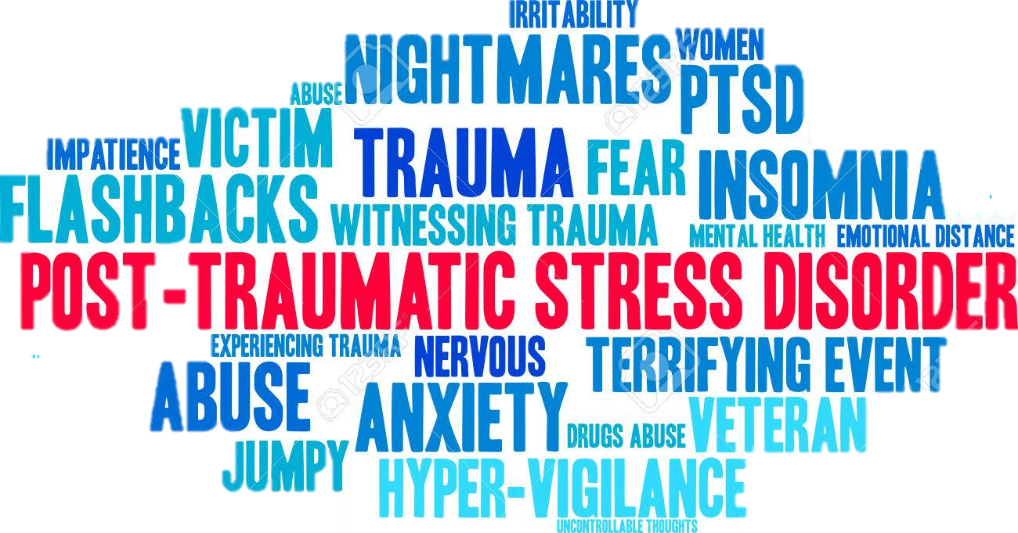
coping mechanism
SELF - CARE
Notes:
The air filter keeps the bad stuff out and let’s the good air in.
Talking it out is the first step
Recognize the signs and symptoms of stress
Express your emotions, write or journal
Relaxation – yoga, meditation, tai chi
Breathe, unplug
Talk it out – stay connected with family, friends
Set goals and priorities (triage)
Be realistic, resist perfectionism
Cultivate gratitude and appreciation
Be in the present – practice mindfulness, meditation
Self-care...
Do something nice for yourself? We all use the excuse we are too busy to take better care of ourselves.
Important way of maintaining our well-being and allowing us to be more resilient in dealing with stress.
Self-care can be an important way to help cope with the distress or uncertainty you might feel.
Self care activities include:
Relaxation
Exercise - most common - good for our brain as well - lowers depression and improve cognitive skills
Eating well
Support from people close to us
Adequate sleep
Go home from work at a reasonable hour
Take self-care actions before you need it.
Self-care activities help us to handle stress.
Be nice to yourself
Self-care has demonstrated a positive effect on our overall health and wellness.
Self-care actions create a habit for what is best for us.
Does not have to require a lot of time.
Learning to take yourself lightly and your problems seriously may improve your quality of life only a little, but small changes can have great consequences.
Page 16 of the report
Let’s be clear, the “Suck it up, Buttercup” mentality is NOT the approach to take.
What does this statement mean to you.
What statements are used in today’s environment? “Not long ago, veteran firefighters derided comrades for wanting to put on air packs before walking into a burning structure. Even today, rookies might express their feelings after their first horrific scene, only to be told by the “seasoned veteran” to “Suck it up, Buttercup.” Let’s be clear, the “Suck it up, Buttercup,” mentality is NOT the approach to take.”
Page 24
Life is short.
Life is intended to be enjoyable.
Faith, family, work should be the priorities of life and our focus.
“Find the joy in your life” Lisa Greco PhD
Comedy is one way to deal with emotional issues - each of us our different and we will find the joy differently.
Kenny Cheney - Don’t blink song
Are you proud of how you lived your life (at least up till this point)?
If you can’t describe the reasons, the ideas and the life examples that make you feel alive, you might look back at your life realizing that you breeze though life without ever having lived.
“Don’t be scared of dying; Be scared of leaving without ever having lived.”
When you live a fulfilling life that’s abundant, the thought of dying becomes less scary because you are not focusing on the fact that you might die, but the wonders and the possibilities you built. Someday, in the future, inevitability will take place and your entire life will flash before your eyes. Make sure it’s a spectacle and majestic view worth watching.
Your Bucket List
In 2007, I watched this movie call “The Bucket List”. It’s about two terminally ill men (Jack Nicholson and Morgan Freeman) on their road trip with a wish list of things to do before they “kick the bucket”. There is this particular scene that I remembered vividly, when both of them are on top of a pyramid drinking and chatting, Morgan Freeman asked Jack Nicholson 2 questions after telling him some story about entering heaven’s gate;
1) Have you found joy in your life?
2) Has your life brought joy to others?
Isn’t it a tough question at times? As we frantically try to give a “politically” correct answer before we give up totally? And seriously, how much we weigh upon our answers? Or even provide an answer with a clear conscience?
I’m thinking hard, and I personally believe it’s never too early or too late to think about these 2 questions.
Have you found joy in your life? (Qn 1 of 2)
Early this year (2014) I saw an awesome video by someone who quitted his job, packed a bag, grabbed his camera and travelled around the world. His catchphrase caught my attention; 17 Countries. 343 Days. 6237 Photographs. One incredible journey.
He compiled a time lapse of the many amazing places he visited and uploaded this YouTube video.
The Good Life (2008)
What really matters in life? Truth be told, you may find that it is already much closer than you think! Here is my take on things that matters, and of which I will definitely find the joy I’m searching for in my life:
Health matters — Poor health will both reduce the time you have in this world and your capability to live the life you want to live. “Nuff Said”
Relationship with our loved ones — They appear in our lives for a reason, and that is to complete us. We complete one another’s lives. We are made that way.
Living a purpose-driven life — You can call it aspiration, life goals, whatever. What is the “YOU” in you? What makes you different to everyone else? Understanding your purpose is a journey that requires time and reflection. Personally, I feel I’ve only understood half of my own life-purpose and for all I know my life-purpose might even change in the near future! Find out what is it that truly makes you feel alive, and that is your life-purpose!
Have your life brought joy to others? (Qn 2 of 2)
This question is much harder to answer because it is a reflection, a third party thought. It is what we ultimately call a healthy relationship (with family, friends, colleagues and simply all humans). They need commitment to work, with lots of effort.
Forgive and forget — Forgiveness is the remedy. You have to let go of what’s behind you before you can hold onto the goodness in front of you.
Admit when you make a mistake — No one is “error-free”. Admitting to a mistake makes you more human anyway.
Be sincere — The greatest power you have in this world is the power of your own self-transformation. Be true to everyone as you would to yourself.
“No matter how rich you become, how famous or powerful, when you die the size of your funeral will still pretty much depend on the weather.” ( Click to Tweet)
Other Quotes from the Movie
There are also some other interesting “quotes” from the movie which I would like to provide here. So sit back and enjoy!
Quote No.1
Carter Chambers: You measure yourself by the people who measure themselves by you.
Quote No.2
Edward Cole: We live, we die, and the wheels on the bus go round and round.
Quote No.3
Carter Chambers: Forty-five years goes by pretty fast;
Edward Cole: Like smoke through a keyhole.
Quote No.4
Carter Chambers: Even now I cannot understand the measure of a life, but I can tell you this. I know that when he died, his eyes were closed and his heart was open. And I’m pretty sure he was happy with his final resting place, because he was buried on the mountain. And that was against the law.
Quote No.5
Edward Cole: The simplest thing is… I loved him. And I missed him. Carter and I saw the world together. Which is amazing… When you think that only three months ago, we were complete strangers! I hope that it doesn’t sound selfish of me but… the last months of his life were the best months of mine. He saved my life… And he knew it before I did.
Quote No.6
Carter Chambers: [in his letter to Edward] Dear Edward, I’ve gone back and forth the last few days trying to decide whether or not I should even write this. In the end, I realized I would regret it if I didn’t, so here it goes. I know the last time we saw each other, we weren’t exactly hitting the sweetest notes — certain wasn’t the way I wanted the trip to end. I suppose I’m responsible and for that, I’m sorry. But in all honestly, if I had the chance, I’d do it again. Virginia said I left a stranger and came back a husband; I owe that to you. There’s no way I can repay you for all you’ve done for me, so rather than try, I’m just going to ask you to do something else for me-find the joy in your life. You once said you’re not everyone. Well, that’s true-you’re certainly not everyone, but everyone is everyone. My pastor always says our lives are streams flowing into the same river towards whatever heaven lies in the mist beyond the falls. Find the joy in your life, Edward. My dear friend, close your eyes and let the waters take you home.
Quote No.7
Edward Cole: … He saved my life, and he knew it before I did. I’m deeply proud that this man found it worth his while to know me. In the end, I think it’s safe to say that we brought some joy to one another’s lives, so one day, when I go to some final resting place, if I happen to wake up next to a certain wall with a gate, I hope that Carter’s there to vouch for me and show me the ropes on the other side.
I do hope that you will be able to provide good answers to the above two questions, but as of now I’m still searching for mine. I sure hope that when the time comes I will have the answers.
“In the end, it’s not the years in your life that count. It’s the life in your years.” ( Click to Tweet)
2 Simple Questions to Ask Before We Die The Bucket list is a great film. The two questions are very important
Slide for chiefs/recruits 22
Tim Conway oldest volunteer firefighters
https://youtu.be/3cIJ_2xttw4
Quote from page 24
Skip

Slide 23
A family member approaches you and relates that lately he/she is having shortness of breath, pain in the arm, and recurring chest pains.
What would you say? What action would you take?
Behavioral Health SIZEUP
23
23

Slide 24
A firefighter approaches you and states “I haven’t been sleeping well after that response the other day.”
He is usually very engaged but now is withdrawn.
What would you say? What action would you take?
Behavioral Health SIZEUP
24
24
Notes:
What’s the difference?
Why is there a difference in your reaction?
We all know and accept “two-in, two-out” for accountability and safety. We should apply the same philosophy to firefighters experiencing reactions to calls.
Two-in, three-out means having a third person who “has the firefighter’s back” regarding emotional safety. This could be a specific person whose role is to be available for emotional wellness support (not necessarily on the fireground), for example, a chaplain, behavioral wellness professional, peer-support team.
We have embraced a strong culture of RIT on the fireground—we need to have just as strong a culture of Emotional RIT.
For chiefs—about culture—the chief sets the tone regarding the stigma of discussing behavioral wellness and reactions to calls. The expectation in the department should be that not only should discussion about behavioral wellness be encouraged, but expected.

Slide 25
WHAT BRINGS “JOY” TO YOUR LIFE?

Slide 26
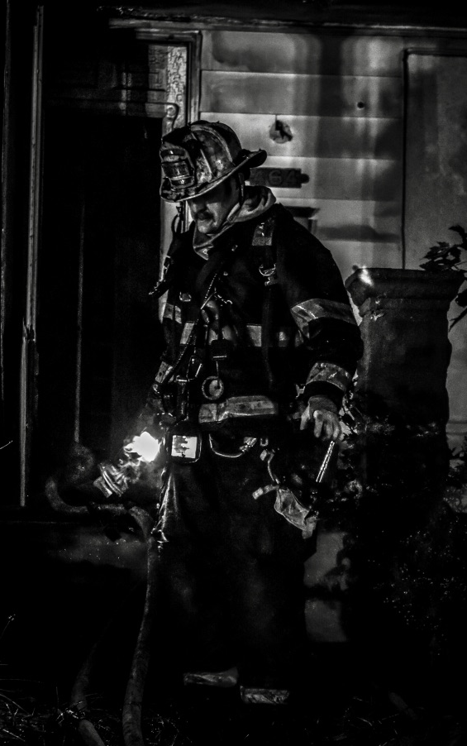
“It’s About The Darkness”
Notes:
Remember you are going to see, smell, touch, hold, become angry and care about the people who ask for your help. This is not television. This is a reality of our job. It won’t happen every day. It will happen when the sun is out and in the darkness of night. You will see blood, dismembered limbs, bodies crushed beyond recognition and others. You will be expected to fix humanities problems. YOU CAN’T FIX EVERY PROBLEM. That is built into a firefighters DNA. We consider ourselves fixers. When we can’t fix things it may bother us. When? We can’t predict and we won’t know in most cases until it happens. You are not Superman. Accept the fact that you are human.
Write the statistics on a board, easel and leave the statistics up for the duration of the presentation.
Page 17
17.9% experience mental illness / US adults
18.1% anxiety disorder / PTSD, obsessive compulsive disorder and specific phobias
Ask Liz about anxiety and how it impacts daily life is it the predominant reaction to stress / worry
Suicide is the 10th leading cause of death in the US representing 1.6% of all deaths
Fire service ???? Statistics about behavioral wellness issues /
What happens - instructor discuss the bold type on page 19
Write some of the list on the board or easel pad.
Writing on the board emphasizes the importance of the information versus just showing a slide and then moving on.
The sad facts of suicide:
• An American dies by suicide every 12.95 minutes
• Suicide is the 10th leading cause of death in the United States
• Suicide is the 2nd leading cause of death for ages 10-24
• Suicide is the 5th leading cause of death for ages 45-59
• For every woman who dies by suicide, 4 men die by suicide(but women are 3x more likely to attempt suicide).
• Depression is the psychiatric diagnosis most commonly associated with suicide.
• Each day in our nation there are an average of over 5,400 attempts by young people grades 7-12.
• Four out of five teen suicide attempts occurred after clear warning signs
• Lesbian, gay, and bisexual youth are more than twice as likely to have attempted suicide as their heterosexual peers.

Slide 27
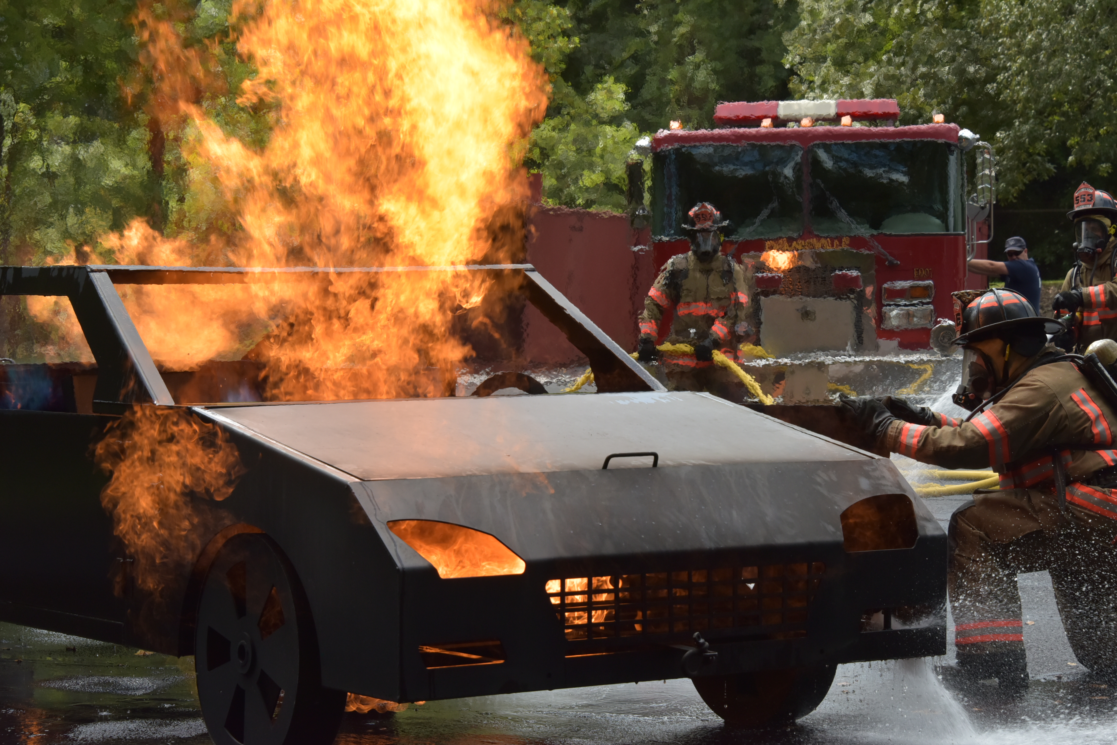
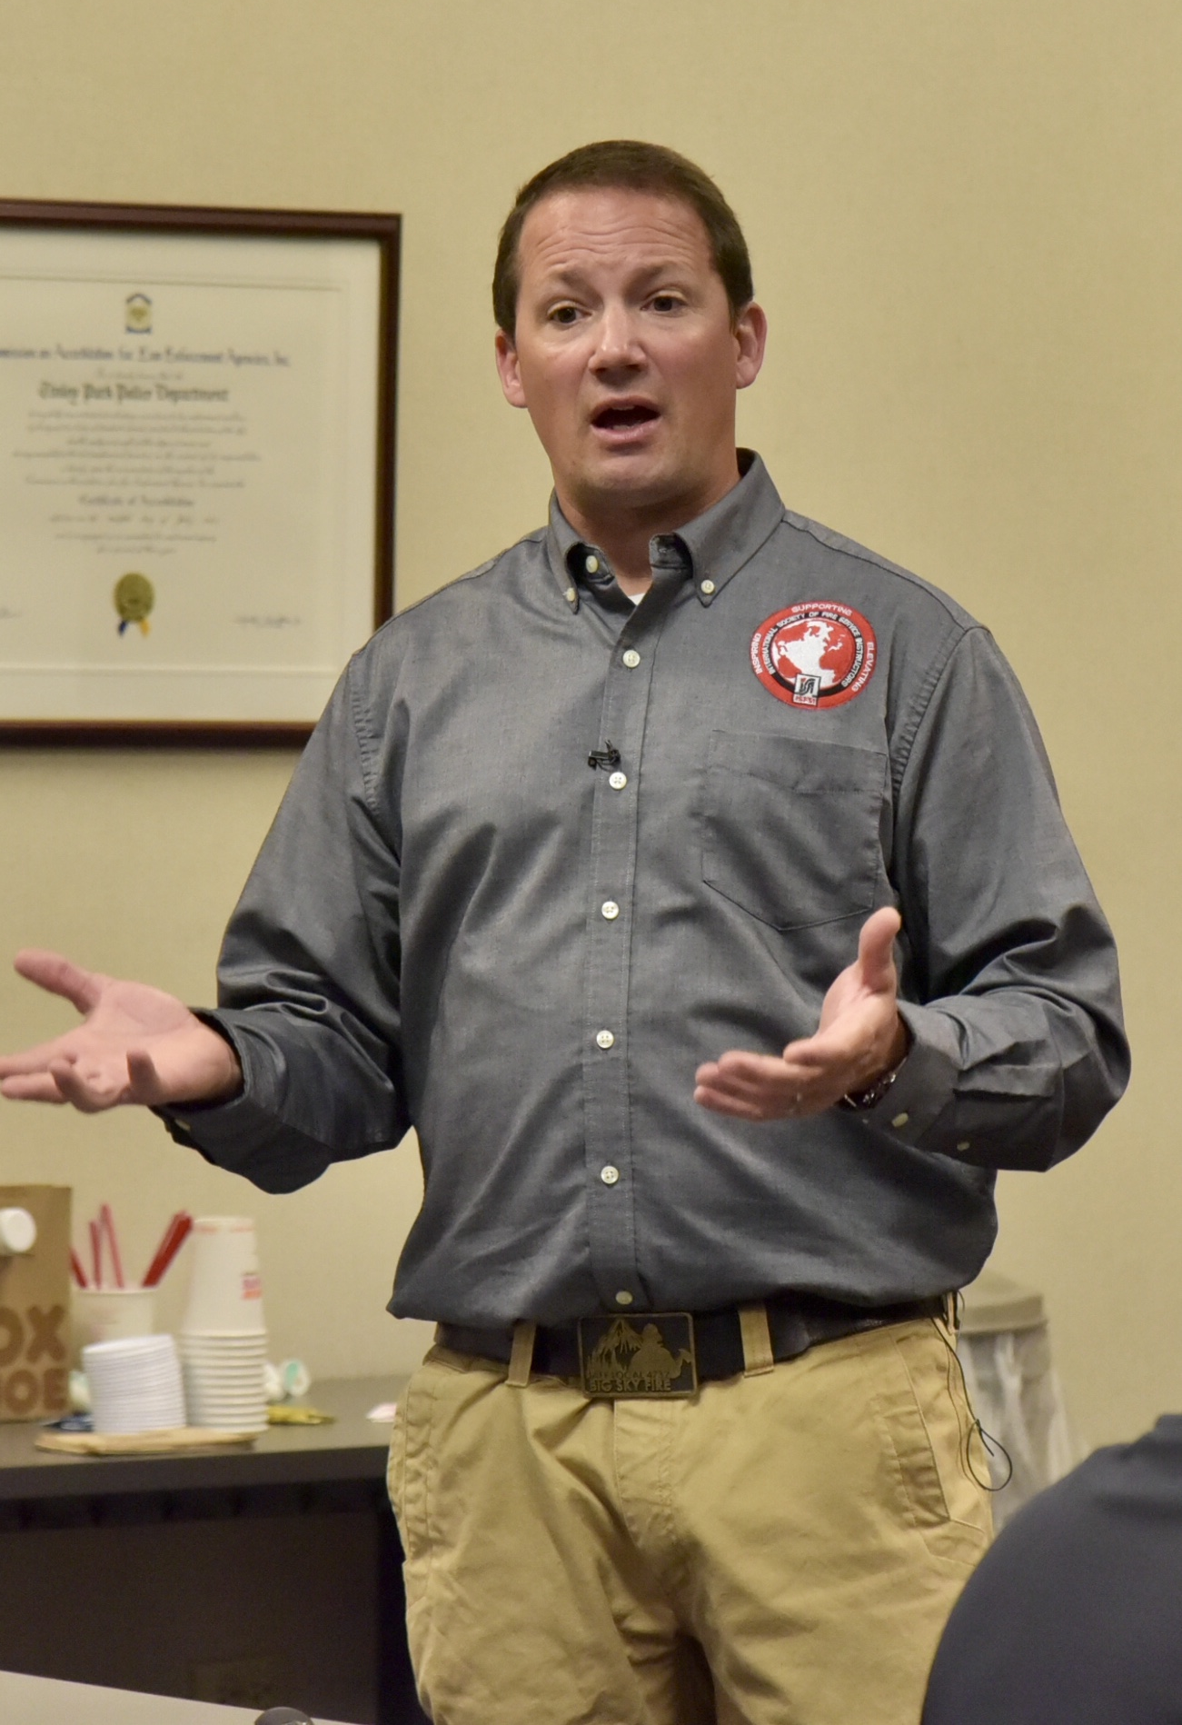
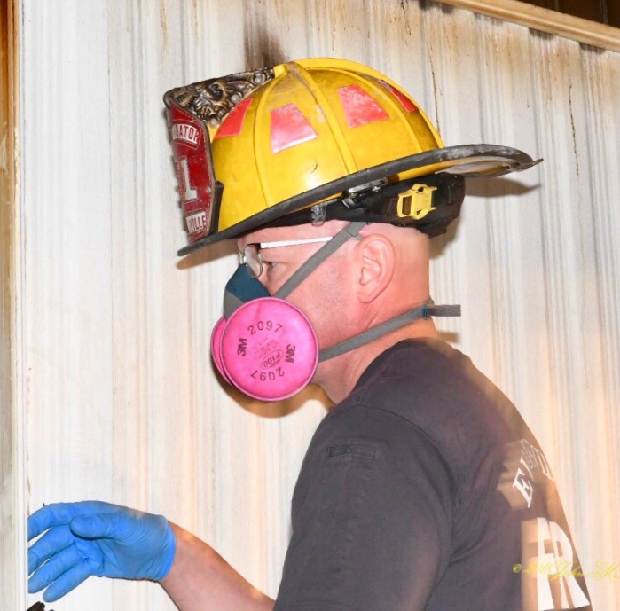
TRIGGERS
Behavioral
Wellness
Notes:
Page 18, 19 and 20 of the YRR
The triggers can evoke negative memories:
Smell – Flower scent reminds you of a funeral/death of a loved one.
Sounds- car back fire reminds you of a gunshot victim.
Visual – Child’s Xbox game violence reminds you of a gruesome accident scene

Slide 28
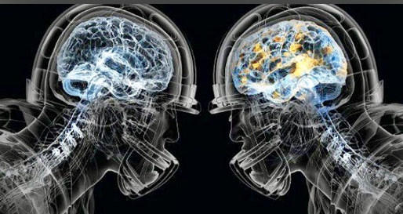
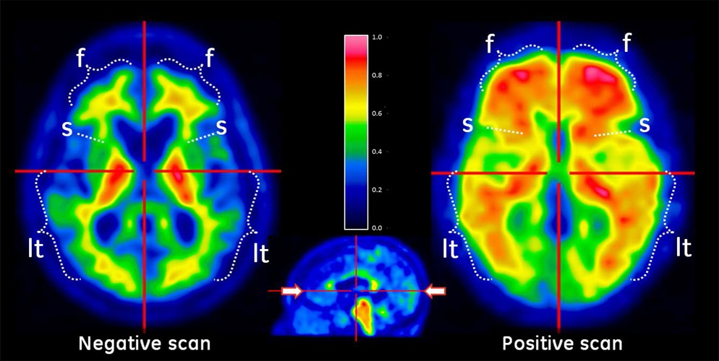
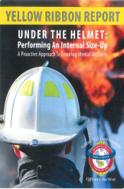
This is your brain…
…with a Traumatic Brain Injury
…with Post Traumatic Stress
Notes:
CBS/AP November 10, 2009, 9:24 AM
Brain Scans Show PTSD Not Just Mental

Slide 29
Peer
To
Peer
EAP
Behavioral
Wellness Support
Programs Available?
In Patient Treatment
Chaplain
Notes:
Instructor notes:
Were the support systems of value? In what way?
If the support system was not helpful why not?
Page 25 Support Model and Infrastructure
Ask the students to look at page 25 of the yellow ribbon report under support model and infrastructure give them 2 minutes to read the information about the different programs.
After the reading is done / ask about the programs available locally and how to access them.
This slide requires the instructor to complete research before the presentation on what is available for his/her specific fire department and how to access.
Peer-support
Chaplaincy
EAP
Behavioral Health resources
Treatment programs
Other organizations

Slide 30
Anxiety
Rage
Hopelessness
Risky Activities
Alcohol Abuse
Behavioral Wellness Problem Clues?
Anger
Withdrawal
Drug Abuse
Notes:
How to Talk About Suicide
Recognizing and Responding to Suicide
A man and woman talking.
Suicide occurs across and within all races and cultures. Within Indian Country, the rates are higher than in the general population. The subject of suicide carries the stigmas of depression and death, the fear that just talking about it will make it happen, and other stigmas, including:
Suicide is a cry for help
When a person decides to end his or her life, there is nothing that can be done to stop him or her
A person won't commit suicide if he or she has children, just bought a new car, or is just having a "difficult time"
The reality is that suicide is preventable, and help is available.
People may not show any signs of the intent to kill themselves before they commit suicide. But there are behaviors that may indicate a person is at risk for killing themselves, and it is important to be aware of warning signs and risk factors. If you notice any warning signs for suicide, starting a conversation with the person may save their life.
Learn to recognize the warning signs:
Hopelessness; feeling like there is no way out
Anxiety, agitation, sleeplessness, or mood swings
Feeling like there is no reason to live
Rage or anger
Engaging in risky activities
Increasing alcohol or drug abuse
Withdrawing from family and friends
The presence of any of the following signs requires immediate attention:
Thinking about hurting or killing themselves
Looking for ways to die
Talking about death, dying, or suicide
Self-destructive or risk taking behavior, especially when it involves alcohol, drugs, or weapons
Resources:
Recognizing and Responding to Suicide Risk in Primary Care (RRSR-PC)
Veterans Crisis Line
National Suicide Prevention Lifeline
How to Begin the Conversation
Before talking with someone you are concerned about, have suicide crisis resources available, such as the National Suicide Prevention Lifeline number, 1-800-273-8255 (TALK), or numbers and addresses of local crisis lines or treatment centers. Mention what signs prompted you to ask about how they are feeling. Mention the warning signs that prompted you to ask the person about how they are feeling, the words used, or behavior displayed (signs make it more difficult to deny that something is wrong).
Ask the Question
Ask directly about suicide. Ask the question in such a way that is natural and flows over the course of the conversation. Ask the question in a way that gives you a "yes" or "no" answer. Don't wait to ask the question when the person is halfway out the door. Asking directly and using the word "suicide" establishes that you and the at-risk person are talking about the same thing, and lets them know you are not afraid to talk about it. Ask:
"Are you thinking about killing yourself?"
or
"Are you thinking about ending your life?"
How NOT to Ask the Question
"You're not thinking about killing yourself, are you?"
Do not ask the question as though you are looking for a "no" answer. Asking the question in this manner tells the person that although you assume they are suicidal, you want and will accept a denial.
Validate the Person' Experience:
Talk openly
Don't panic
Be willing to listen and allow emotional expression
Recognize that the situation is serious
Don't pass judgment
Reassure that help is available
Don't promise secrecy
Don't leave the person alone
Get Help
Share available resources with the person. Be willing to make the call, or take part in the call to the National Suicide Prevention Lifeline at 1-800-273-8255 (Talk). The toll-free confidential Lifeline is available 24 hours a day, seven days a week.
Let the person know that you are willing to go with them to see a professional when they are ready. If you feel the situation is critical, take the person the closest Emergency Room or call 9-1-1. Do not put yourself in danger; if at any time during the process you are concerned about your own safety, or that the person may harm others, call 9-1-1.
Never negotiate with a person who has a gun, call 9-1-1 and leave the area.
If the person has done harm to him or herself in any way, call 9-1-1.

Slide 31
FEELING TRAPPED
RAGE
PROBLEM CLUES
WITHDRAWING
AGGRESSION
BURDEN TO OTHERS
REVENGE
HUMILIATION
GIVING AWAY POSSESSIONS
SUBSTANCE ABUSE
SLEEPLESSNESS
RECKLESSNESS
ANXIETY
SAYING GOODBYE
Notes:
How to Talk About Suicide
Recognizing and Responding to Suicide
A man and woman talking.
Suicide occurs across and within all races and cultures. Within Indian Country, the rates are higher than in the general population. The subject of suicide carries the stigmas of depression and death, the fear that just talking about it will make it happen, and other stigmas, including:
Suicide is a cry for help
When a person decides to end his or her life, there is nothing that can be done to stop him or her
A person won't commit suicide if he or she has children, just bought a new car, or is just having a "difficult time"
The reality is that suicide is preventable, and help is available.
People may not show any signs of the intent to kill themselves before they commit suicide. But there are behaviors that may indicate a person is at risk for killing themselves, and it is important to be aware of warning signs and risk factors. If you notice any warning signs for suicide, starting a conversation with the person may save their life.
Learn to recognize the warning signs:
Hopelessness; feeling like there is no way out
Anxiety, agitation, sleeplessness, or mood swings
Feeling like there is no reason to live
Rage or anger
Engaging in risky activities
Increasing alcohol or drug abuse
Withdrawing from family and friends
The presence of any of the following signs requires immediate attention:
Thinking about hurting or killing themselves
Looking for ways to die
Talking about death, dying, or suicide
Self-destructive or risk taking behavior, especially when it involves alcohol, drugs, or weapons
Resources:
Recognizing and Responding to Suicide Risk in Primary Care (RRSR-PC)
Veterans Crisis Line
National Suicide Prevention Lifeline
How to Begin the Conversation
Before talking with someone you are concerned about, have suicide crisis resources available, such as the National Suicide Prevention Lifeline number, 1-800-273-8255 (TALK), or numbers and addresses of local crisis lines or treatment centers. Mention what signs prompted you to ask about how they are feeling. Mention the warning signs that prompted you to ask the person about how they are feeling, the words used, or behavior displayed (signs make it more difficult to deny that something is wrong).
Ask the Question
Ask directly about suicide. Ask the question in such a way that is natural and flows over the course of the conversation. Ask the question in a way that gives you a "yes" or "no" answer. Don't wait to ask the question when the person is halfway out the door. Asking directly and using the word "suicide" establishes that you and the at-risk person are talking about the same thing, and lets them know you are not afraid to talk about it. Ask:
"Are you thinking about killing yourself?"
or
"Are you thinking about ending your life?"
How NOT to Ask the Question
"You're not thinking about killing yourself, are you?"
Do not ask the question as though you are looking for a "no" answer. Asking the question in this manner tells the person that although you assume they are suicidal, you want and will accept a denial.
Validate the Person' Experience:
Talk openly
Don't panic
Be willing to listen and allow emotional expression
Recognize that the situation is serious
Don't pass judgment
Reassure that help is available
Don't promise secrecy
Don't leave the person alone
Get Help
Share available resources with the person. Be willing to make the call, or take part in the call to the National Suicide Prevention Lifeline at 1-800-273-8255 (Talk). The toll-free confidential Lifeline is available 24 hours a day, seven days a week.
Let the person know that you are willing to go with them to see a professional when they are ready. If you feel the situation is critical, take the person the closest Emergency Room or call 9-1-1. Do not put yourself in danger; if at any time during the process you are concerned about your own safety, or that the person may harm others, call 9-1-1.
Never negotiate with a person who has a gun, call 9-1-1 and leave the area.
If the person has done harm to him or herself in any way, call 9-1-1.
Saying “I’ve got it all figured out now—I know what I am going to do” regarding a problem.

Slide 32
“It’s Not As Easy As Cleaning Your Gear”
John M. Buckman III
You can’t talk about a situation one time and wash away all of the dirt...
Notes:
Addressing behavioral wellness issues with firefighters will be an ongoing process requiring long-term commitment.
You can’t talk about a situation one time and wash away all of the dirt associated with that event.

Slide 33
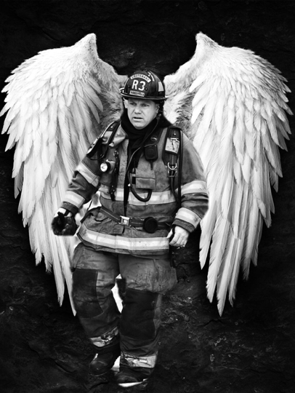
Cumulative Effects
Cumulative Effects
Cumulative Effects

Slide 34
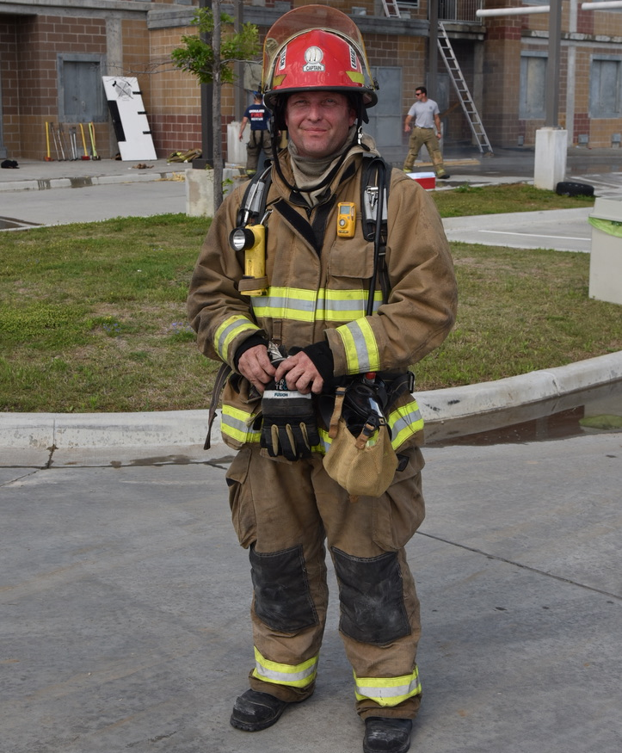
IMPLEMENTATION OPTIONS
“ONE SIZE DOES NOT FIT ALL”
Notes:
Peer support programs
As a component of a full Critical Incident Stress Management program, individual department members can play an important part within a Behavioral Wellness Program. Identify individuals in the department who are well-suited and have the desire to serve in this capacity; these individuals should be trained using known peer support models (e.g., International Critical Incident Stress Foundation).
Chaplaincy Programs
In the best case scenario, Fire Service Chaplains should have specialized education, training, and experience specific to the fire service.
Consider sending your chaplain to orientation classes, NIMS classes, CISM training, Chaplaincy training, etcetera and let them train alongside your personnel.
The Federation of Fire Chaplains is one great resource for assistance in locating a chaplain near you, as well as being a great training resource for your chaplain. Selecting a chaplain who is or has been a first responder is ideal. Consider sponsoring one of your own who has felt the call to go through training to become a chaplain.
Employee Assistance Program
Ensure that EAP personnel are vetted and have specific education in firefighter culture, exposure to trauma, and the unique experiences that we encounter that can lead to emotional and behavioral health problems.
Why is vetting needed? You might have even heard some of the stories… a brother or sister firefighter goes to a therapist to talk about a really bad call. They come back to the station the next shift and tell everyone that they will never go back because the counselor had “no idea what we see and hear and smell.”
You see, it’s not because the therapist wasn’t wanting to help, it was because they truly don’t understand our culture.
As a note, the Firefighter Behavioral Health Alliance (along NFFF and a few other organizations) actually have classes designed to familiarize counselors with the Fire Service culture.
Other Behavioral health resources
Even if your department has an Employee Assistance Program (EAP) – and especially if you don’t - it may be beneficial to identify therapists who specialize in working with first responders as an additional (or primary) resource.
Another consideration regarding the proactiveness in establishing a BHP is this; talk to your health insurance carrier! Some things to ask;
Are their Behavioral Health Benefits?
If so, many health insurance companies have a special “mental health inquiries” phone number on the back of their insurance cards.
Are their financial limits?
Are their visit limits?
Treatment Programs
Become aware of outpatient and inpatient professional treatment programs which are appropriate for first responders.
This is another great ‘tool’ for you BHP toolkit.
There are a few in-patient and out-patient programs designed especially for first responders. Contact some of them to find out;
Do they accept insurance? (many are cash only – though some of those programs offer ‘scholarships’ to help offset a portion of the costs)
What is criteria for admission? (some are licensed only for a primary diagnosis of substance abuse)
What is the wait time to be seen? (long term facilities tend to have an extended wait time for admission)
Other Resources
In addition to VCOS resources, use the resources from the IAFF Behavioral Health Program (IAFF members only), the National Fallen Firefighters Foundation, the Firefighter Behavioral Health Alliance, the International Association of Fire Chiefs, the National Volunteer Fire Council, and others.

Slide 35
RESPECT YOUR BODY
EXERCISE
BREATHE
GET CONTROL OVER YOUR LIFE
TALK IT OUT
PRACTICE MINDFULNESS
DEALING WITH STRESS
31
Notes:
PAGE 21

Slide 36
We will close with the words…
“We ain’t superheroes; we’re just ordinary people, trying to make a difference and the first on every scene. It’s a heavy, heavy burden, to carry all this hurtin’, when you can’t unsee the things you’ve seen. It keeps goin’ on, when those sirens are gone.”
Kevin Davison, Firefighter/Paramedic, Kentville, Novia Scotia, Canada
Notes:
Impact at home
Cumulative effects of emergency service carry over at home. As you just saw in the video, what were some of the things that you noticed when Kevin got home?
He experiences nightmares
He experiences flashbacks
Wife is talking and he is still thinking about the call
Special thanks to Kevin Davison for “When Those Sirens Are Gone.”

Slide 37
Infrastructure Support
When Those Sirens Are Gone
Notes:
Impact at home
Cumulative effects of emergency service carry over at home. As you just saw in the video, what were some of the things that you noticed when Kevin got home?
He experiences nightmares
He experiences flashbacks
Wife is talking and he is still thinking about the call
Special thanks to Kevin Davison for “When Those Sirens Are Gone.”

Slide 38
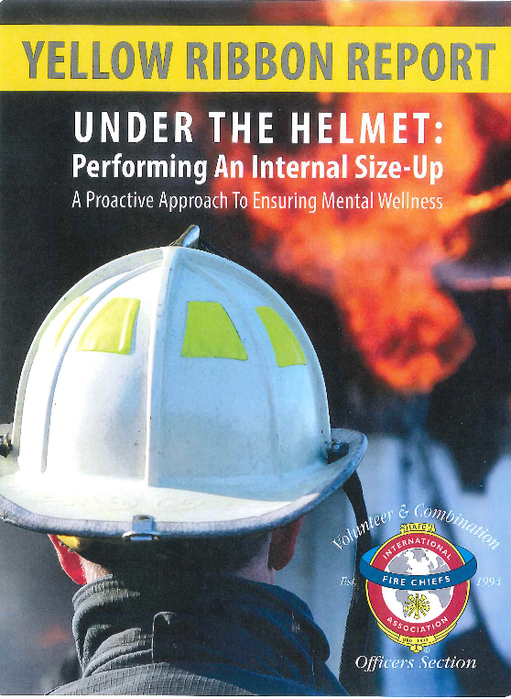
Questions?
Go make a difference. Be the difference.

Slide 40
Dealing with Stress: Coping Mechanisms
World’s oldest firefighter
Notes:
https://youtu.be/3qqE_WmagjY

Slide 41
https://www.youtube.com/watch?v=nF_C3bO8WZ0

