Slide 1
Behavioral Wellness: Firefighter Level Training
Based on the Yellow Ribbon Report developed by the IAFC Volunteer Combination Officers Section
Notes:
Instructor Notes:
See it.
Hear it.
Say it.
Write it.
Reinforce the lessons in this program.
Discuss briefly the history of the Yellow Ribbon Report, how VCOS developed it (workshop November 2016 with compiling, editing, authors from fire service, chaplaincy, clinician, and an academic)
YRR released at FRI in July 2017—positive reaction, but chiefs wanted more on HOW to develop and implement behavioral health programs for their departments.
Discuss how that led to the development of this training, mention focus group November 2017 (specifics on next slide)

Slide 2
Behavioral Wellness Operations Training
Chief Donna Black
Duck, NC
Board Member
IAFC Rep.
Chief Jim Cook
Leesburg VA
Board Member
Chief Rich Cowger
MT
Vice Chair
Chief Al Yancey
IL
Board Member
Chief Jason Catatrombe
Board Member
Chief Ed Rush
NY
Board Member
Chief Ron Oettel
Board Member
Chief Tim Wall
Wallingford CT
Chair Emeritus
VCOS Board Members:
Chief Chuck Flynn
Suffield, CT
Chair
Chief Fred Windisch
Ponderosa TX
Treasurer
Chief Norvin Collins
Board Member

Slide 3
Contributing Authors
Elizabeth Fletcher
Skip Straus
Contributing Authors:
John M. Buckman III
Elizabeth Fletcher
Pat Kenny
Skip Straus
John M. Buckman III
Pat Kenny

Slide 4
Behavioral Wellness: Firefighter Level Training
Instructor Add Your Name and Bio.

Slide 5
YRR Training Mission
Provide education and training to firefighters through an interactive facilitated presentation style:
Recruit/Firefighter
Officer
Chief
Notes:
Explain the levels of training and use comments from the report
Awareness - basic information about the issue
Operations - programs and actions
Technician - professional services integration
Chief Level - leadership responsibilities
Build the sandwich

Slide 6
Training Objectives
The student shall be able to:
Define acute stress
Define chronic stress
Discuss the impact on families:
Suicide
Alcohol
Drugs
Etc.
Identify support programs
Identify family support programs
Actions to take at the Company/Battalion Level

Slide 7
Behavioral Wellness: Awareness Level Training
Group Introductions

Slide 8
Signs, symptoms, and actions to protect...
Accept we can’t always deal with stress...
Behavioral health affected firefighters for years...
Acknowledge and accepting the mental and physical impact...
Impact stress brings to our family, children...
Page 8 Yellow Ribbon Report
Written by Chief John M. Buckman III
Notes:
Refer students to page 8 of the YRR

Slide 9
Human Reactions
0 to 60 mph
Listen
Involve
Help Is Available
Accept
Talk
Education Programs
Cultural Change / Behavioral Health
8
Notes:
Page 16 / bottom paragraph
Page 27 organizational size up questions

Slide 10
Video provided by the National Volunteer Fire Council
Introduction to Behavioral Wellness Action Items
https://vimeo.com/280976161

Slide 11
As firefighters, you will…
witness the miracle of birth
cry with your patients
hold a baby in your arms as it takes it’s last breath
be vomited upon
Have cookies brought to the fire station
control bleeding
Receive a thank you card from a grateful resident
say a short, silent prayer for a patient
Have a kid come up to you and hug your leg
comfort a father who held his dead son in his arms and grieved with the greatest sorrow
Be promoted to an officer rank
Carry valuables out of a house after putting the fire out
Chief Gary Ludwig, Champaign, IL Fire Dept., author, excerpted from Blood, Sweat, Tears, and Prayers

Slide 12
Little written
Minimal education
Don’t know how to deal with depression, anxiety, substance abuse and addiction.
Don’t have knowledge or resources
Action Statement 2
Fire departments need to become familiar with emotional and behavioral health issues and methods of reducing their impact on members.
Notes:
From the Yellow Ribbon Report page 15
Page 24 Education and Training discuss with students what kind of education they received and what they believe they need.

Slide 13
Stress Management
Your reaction to the stress of life will impact your long-term health and wellness. You will experience events on the job that will be overwhelming and will create a stress-related reaction.
Recognize this job is not always fun and when it hurts ask for help.
Notes:
Page 14 YRR
Able to deal on the job stressors, plus all the parts of daily life everyone else faces, but dealing with our own internal stress “bucket” is not always a priority.

Slide 14
The tone at the kitchen table will impact behavioral wellness.
“Everything good happens at the kitchen table”
Chief Alan Brunacini

Slide 15
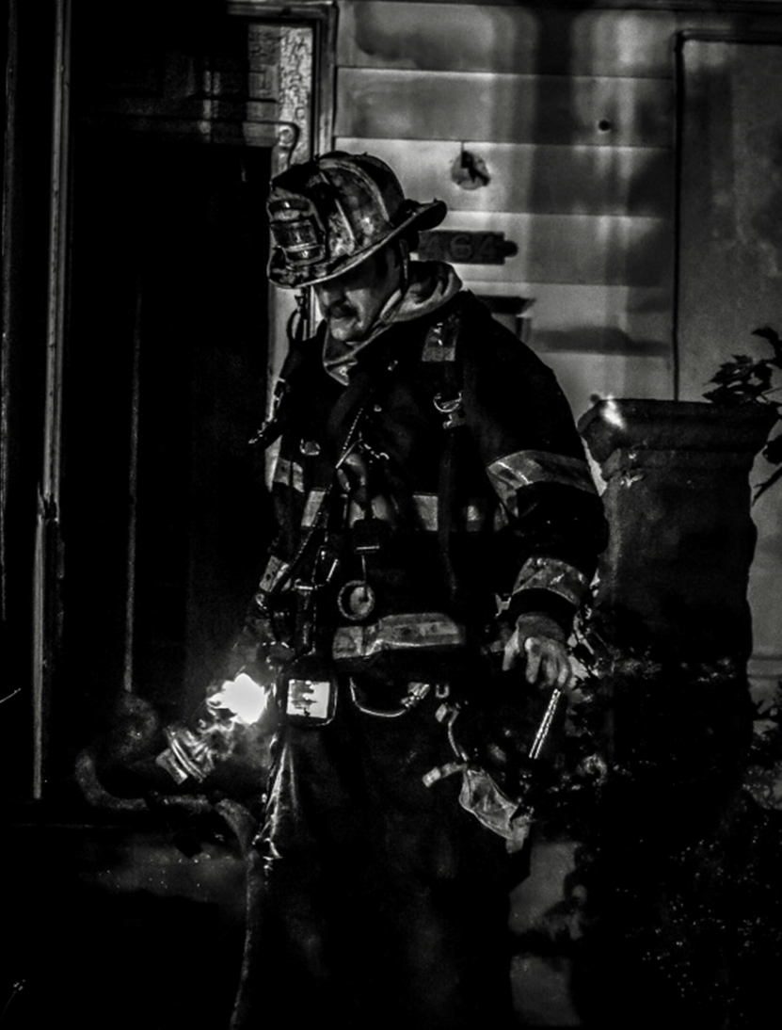
Difference between HELPING and FIXING.
14

Slide 16
You are always in my mind…not real but like a ghost to me…
14

Slide 17
Dramatizing What We Do May Not Be Healthy?
Notes:
Instructor note:
Based upon the question ask the students if the statement is true or false?
What are the consequences of telling new recruits of those “good” responses that usually involve trauma? What is the purpose of sharing the story? Lessons learned might be acceptable but telling the story to let others know how tough you are may not really be appropriate?
What we do is life and death. Life is good. Dealing with death is not good. Public Safety personnel have to learn how to deal with traumatic events up to death.

Slide 18
“It’s Not As Easy As Cleaning Your Gear”
John M. Buckman III
You can’t talk about a situation one time and wash away all of the dirt...
Notes:
Addressing behavioral wellness issues with firefighters will be an ongoing process requiring long-term commitment.
You can’t talk about a situation one time and wash away all of the dirt associated with that event.

Slide 19
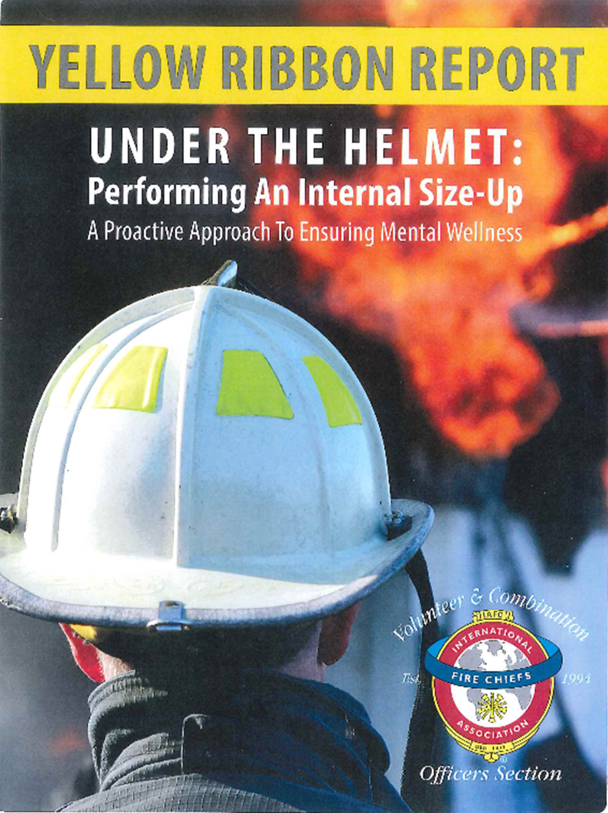
The Yellow Ribbon Report
How Do You Create a Culture of Trust?
Notes:
Instructor Note
Ask students the questions on the screen.
You might ask the students how trust is evident in a company? What actions show trust?
Write student responses on a white board/easel pad.
Page 14 YRR has several actions for establishing trust
Here are some additional examples of answers
Communicate often - listen more than talking
Recognize excellence
Show vulnerability
Trust is not optional within the company.
Expand the role of trust.
We trust each other during an emergency response.
Do they trust each other around the kitchen table.
Trust impacts your ability to recruit and retain the best for your company and department.

Slide 20
The Yellow Ribbon Report
What is your FD behavioral wellness culture?

Slide 21
Critical Incidents—Community Impact
What community events out of our control impact our behavioral wellness?
How do those events impact our personal behavioral wellness?
Notes:
What events...
MVA’s with multiple trauma events
Birth of a baby
Death of a child?

Slide 22
Impact of Suicide on the Families
Leslie Dangerfield’s interview on WGN Chicago
https://www.youtube.com/watch?v=qngleqS5dts
Notes:
Leslie Dangerfield’s interview on WGN Chicago
https://www.youtube.com/watch?v=qngleqS5dts
Why is “Families” plural?
The home family – Lisa Dangerfield, wife and sons Christopher and Bryce
The fire family – Indian River County Fire Rescue: Station 8 (current Battalion Chief), Station 1 (Captain 3 years), Station 2 (Lieutenant for most of his 24-year career)
Why is “Families” plural?
Home family
Fire family

Slide 23
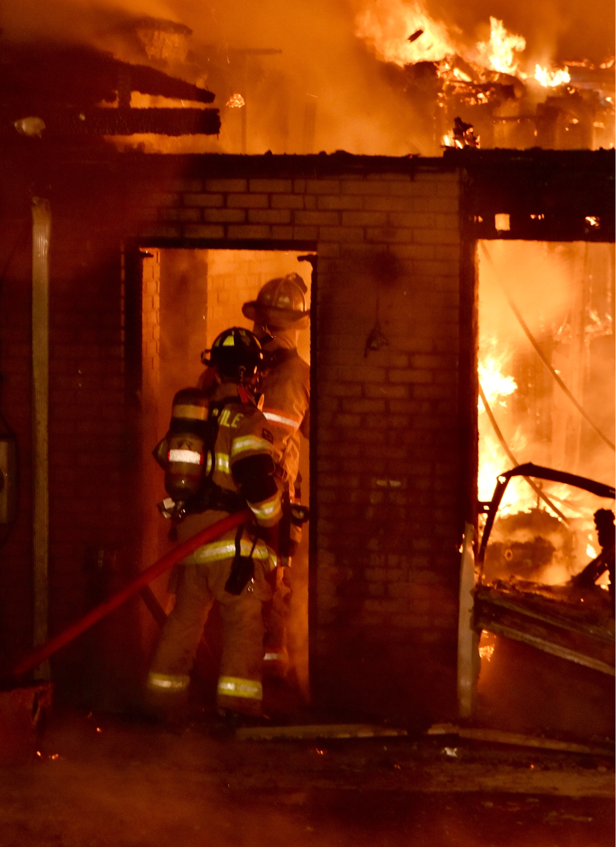
Stress Behavioral Reaction
“Fight or Flight” Response
Acute Stress
Single event
Chronic
long term
Cumulative Stress
build up
Reduce the high/highs and the low/lows
Notes:
Chronic (Cumulative) Stress
Unprocessed and stuffed down results in chronic stress.
We have not been taught how to process personal and professional stress.
Emotions can manifest themselves
Leading to anxiety, depression, substance abuse, and addiction
Suicide
There’s is no additional information other than the words on the slide?
What does this mean?
“fight, flight, or freeze” response—some people actually shut down and become incapacitated.
Need more explanation of the material
This stress response Impacts your job performance.
The mind does not know the difference between a real threat and a perceived threat. What comes into the mind the body reacts.
“Fight or Flight” Response
Four Mind-Body Changes:
Redirection of blood to the brain and large muscle groups from extremities
Heightened sense of alertness (e.g., vision and hearing sharpen)
Release of glucose and fatty acids for fuel
Shutting down of immune system and restorative processes (e.g., digestion)
Return to “Rest and Digest” when threat is over
Common short-term reactions:
Emotional responses
Disrupted sleep or insomnia
Confusion or lack of clarity
Appetite changes
Denying or minimizing the event’s (or events’) impact on us
Possible Long-term reactions:
Worry and anxiety
Lowered frustration tolerance and impatience
Irritability
Withdrawal
Depression or feelings of numbness
Denial or minimization of impact
Sleep problems, insomnia
Nightmares, night sweats
Teeth grinding at night or even while awake

Slide 24
Behavioral Reaction to Stress

Slide 25
BE PROACTIVE - accept accountability for the emotional well-being of your firefighter/company.
Psychological First Aid
21
Notes:
Page 28 and 29
Refer to the checklist
Have the students review the checklist
Ask if there are any questions or comments about the checklist
Can it be implemented at your company/FD?
Page 29 Psychological First Aid
Action Steps
Review those actions

Slide 26
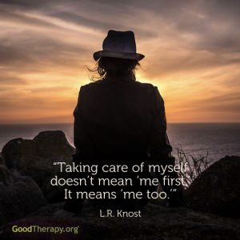
Compassion Fatigue
“Frequent Flyers”
21
Notes:
Page 28 and 29
Refer to the checklist
Have the students review the checklist
Ask if there are any questions or comments about the checklist
Can it be implemented at your company/FD?
Page 29 Psychological First Aid
Action Steps
Review those actions

Slide 27
Family Impact Behavioral Wellness?
Professional Impact Behavioral Wellness?
Happy
Prosper
Positive Outlook on Life In General
Financial Stability
Health
Demotion
Withdrawal
Termination
Transfer
Injury
Anxiety
Depression
Suicide
Ignore spouse
Divorce
Ignore children
Ignore friends
Alcohol/Drug Abuse
Depression
Anxiety

Slide 28
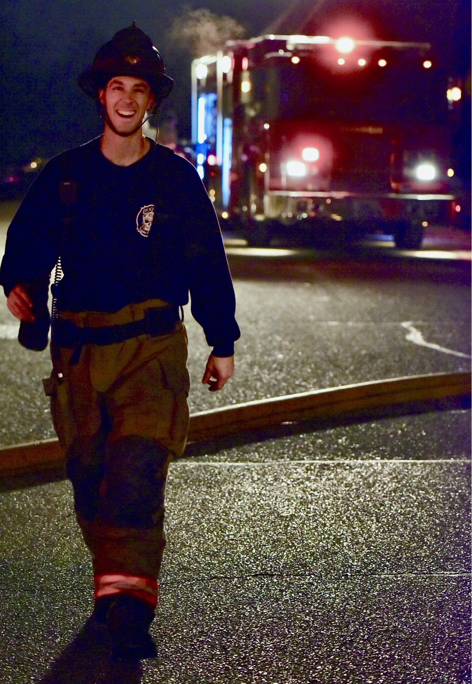
“Advocate”

Slide 29
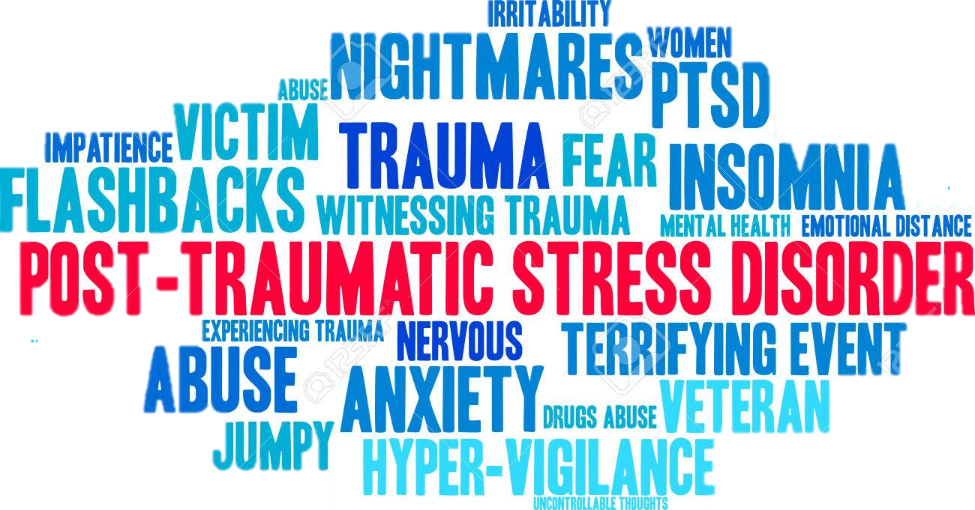
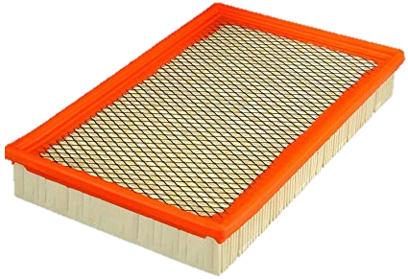
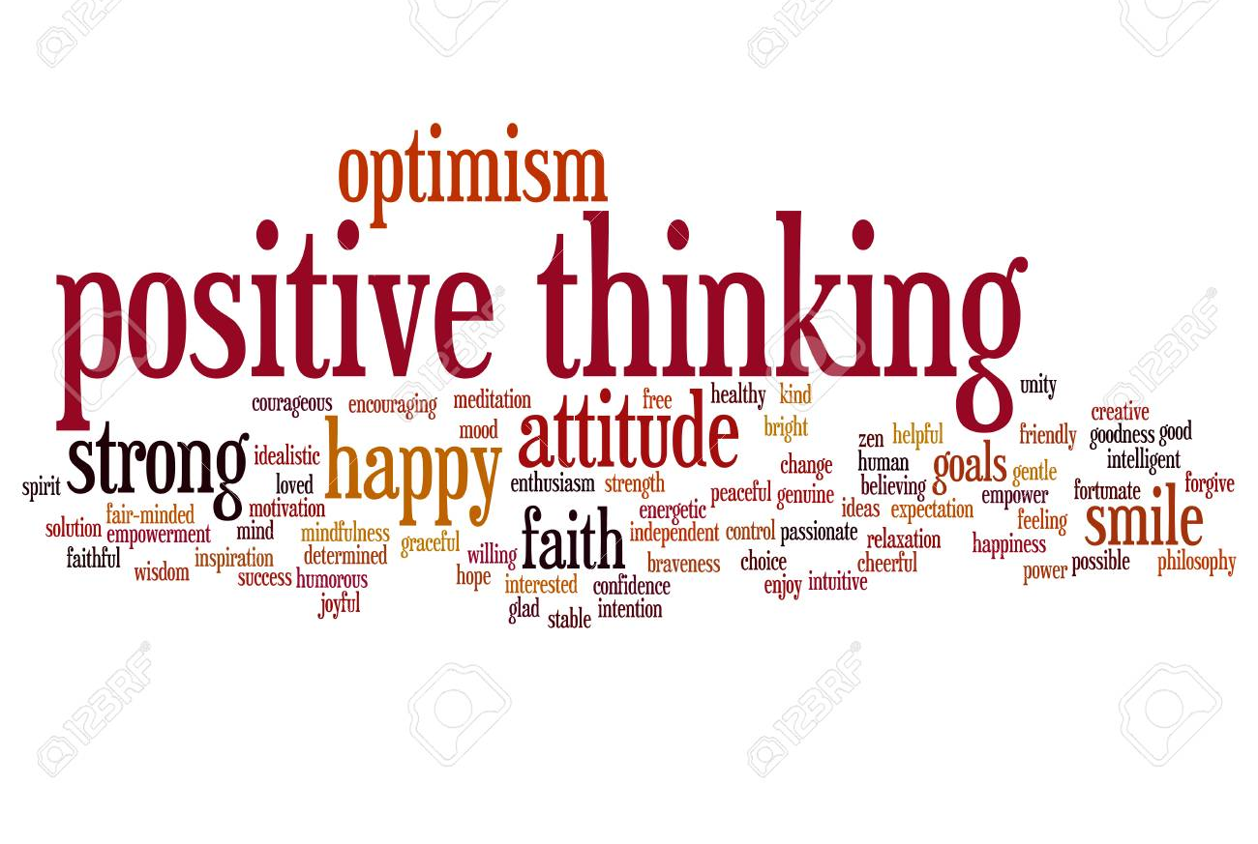
coping mechanism
SELF - CARE
Notes:
The air filter keeps the bad stuff out and let’s the good air in.
Talking it out is the first step
Recognize the signs and symptoms of stress
Express your emotions, write or journal
Relaxation – yoga, meditation, tai chi
Breathe, unplug
Talk it out – stay connected with family, friends
Set goals and priorities (triage)
Be realistic, resist perfectionism
Cultivate gratitude and appreciation
Be in the present – practice mindfulness, meditation
Self-care...
Do something nice for yourself? We all use the excuse we are too busy to take better care of ourselves.
Important way of maintaining our well-being and allowing us to be more resilient in dealing with stress.
Self-care can be an important way to help cope with the distress or uncertainty you might feel.
Self care activities include:
Relaxation
Exercise - most common - good for our brain as well - lowers depression and improve cognitive skills
Eating well
Support from people close to us
Adequate sleep
Go home from work at a reasonable hour
Take self-care actions before you need it.
Self-care activities help us to handle stress.
Be nice to yourself
Self-care has demonstrated a positive effect on our overall health and wellness.
Self-care actions create a habit for what is best for us.
Does not have to require a lot of time.
Learning to take yourself lightly and your problems seriously may improve your quality of life only a little, but small changes can have great consequences.
Page 16 of the report
Let’s be clear, the “Suck it up, Buttercup” mentality is NOT the approach to take.
What does this statement mean to you.
What statements are used in today’s environment? “Not long ago, veteran firefighters derided comrades for wanting to put on air packs before walking into a burning structure. Even today, rookies might express their feelings after their first horrific scene, only to be told by the “seasoned veteran” to “Suck it up, Buttercup.” Let’s be clear, the “Suck it up, Buttercup,” mentality is NOT the approach to take.”
Page 24
Life is short.
Life is intended to be enjoyable.
Faith, family, work should be the priorities of life and our focus.
“Find the joy in your life” Lisa Greco PhD
Comedy is one way to deal with emotional issues - each of us our different and we will find the joy differently.
Kenny Cheney - Don’t blink song
Are you proud of how you lived your life (at least up till this point)?
If you can’t describe the reasons, the ideas and the life examples that make you feel alive, you might look back at your life realizing that you breeze though life without ever having lived.
“Don’t be scared of dying; Be scared of leaving without ever having lived.”
When you live a fulfilling life that’s abundant, the thought of dying becomes less scary because you are not focusing on the fact that you might die, but the wonders and the possibilities you built. Someday, in the future, inevitability will take place and your entire life will flash before your eyes. Make sure it’s a spectacle and majestic view worth watching.
Your Bucket List
In 2007, I watched this movie call “The Bucket List”. It’s about two terminally ill men (Jack Nicholson and Morgan Freeman) on their road trip with a wish list of things to do before they “kick the bucket”. There is this particular scene that I remembered vividly, when both of them are on top of a pyramid drinking and chatting, Morgan Freeman asked Jack Nicholson 2 questions after telling him some story about entering heaven’s gate;
1) Have you found joy in your life?
2) Has your life brought joy to others?
Isn’t it a tough question at times? As we frantically try to give a “politically” correct answer before we give up totally? And seriously, how much we weigh upon our answers? Or even provide an answer with a clear conscience?
I’m thinking hard, and I personally believe it’s never too early or too late to think about these 2 questions.
Have you found joy in your life? (Qn 1 of 2)
Early this year (2014) I saw an awesome video by someone who quitted his job, packed a bag, grabbed his camera and travelled around the world. His catchphrase caught my attention; 17 Countries. 343 Days. 6237 Photographs. One incredible journey.
He compiled a time lapse of the many amazing places he visited and uploaded this YouTube video.
The Good Life (2008)
What really matters in life? Truth be told, you may find that it is already much closer than you think! Here is my take on things that matters, and of which I will definitely find the joy I’m searching for in my life:
Health matters — Poor health will both reduce the time you have in this world and your capability to live the life you want to live. “Nuff Said”
Relationship with our loved ones — They appear in our lives for a reason, and that is to complete us. We complete one another’s lives. We are made that way.
Living a purpose-driven life — You can call it aspiration, life goals, whatever. What is the “YOU” in you? What makes you different to everyone else? Understanding your purpose is a journey that requires time and reflection. Personally, I feel I’ve only understood half of my own life-purpose and for all I know my life-purpose might even change in the near future! Find out what is it that truly makes you feel alive, and that is your life-purpose!
Have your life brought joy to others? (Qn 2 of 2)
This question is much harder to answer because it is a reflection, a third party thought. It is what we ultimately call a healthy relationship (with family, friends, colleagues and simply all humans). They need commitment to work, with lots of effort.
Forgive and forget — Forgiveness is the remedy. You have to let go of what’s behind you before you can hold onto the goodness in front of you.
Admit when you make a mistake — No one is “error-free”. Admitting to a mistake makes you more human anyway.
Be sincere — The greatest power you have in this world is the power of your own self-transformation. Be true to everyone as you would to yourself.
“No matter how rich you become, how famous or powerful, when you die the size of your funeral will still pretty much depend on the weather.” ( Click to Tweet)
Other Quotes from the Movie
There are also some other interesting “quotes” from the movie which I would like to provide here. So sit back and enjoy!
Quote No.1
Carter Chambers: You measure yourself by the people who measure themselves by you.
Quote No.2
Edward Cole: We live, we die, and the wheels on the bus go round and round.
Quote No.3
Carter Chambers: Forty-five years goes by pretty fast;
Edward Cole: Like smoke through a keyhole.
Quote No.4
Carter Chambers: Even now I cannot understand the measure of a life, but I can tell you this. I know that when he died, his eyes were closed and his heart was open. And I’m pretty sure he was happy with his final resting place, because he was buried on the mountain. And that was against the law.
Quote No.5
Edward Cole: The simplest thing is… I loved him. And I missed him. Carter and I saw the world together. Which is amazing… When you think that only three months ago, we were complete strangers! I hope that it doesn’t sound selfish of me but… the last months of his life were the best months of mine. He saved my life… And he knew it before I did.
Quote No.6
Carter Chambers: [in his letter to Edward] Dear Edward, I’ve gone back and forth the last few days trying to decide whether or not I should even write this. In the end, I realized I would regret it if I didn’t, so here it goes. I know the last time we saw each other, we weren’t exactly hitting the sweetest notes — certain wasn’t the way I wanted the trip to end. I suppose I’m responsible and for that, I’m sorry. But in all honestly, if I had the chance, I’d do it again. Virginia said I left a stranger and came back a husband; I owe that to you. There’s no way I can repay you for all you’ve done for me, so rather than try, I’m just going to ask you to do something else for me-find the joy in your life. You once said you’re not everyone. Well, that’s true-you’re certainly not everyone, but everyone is everyone. My pastor always says our lives are streams flowing into the same river towards whatever heaven lies in the mist beyond the falls. Find the joy in your life, Edward. My dear friend, close your eyes and let the waters take you home.
Quote No.7
Edward Cole: … He saved my life, and he knew it before I did. I’m deeply proud that this man found it worth his while to know me. In the end, I think it’s safe to say that we brought some joy to one another’s lives, so one day, when I go to some final resting place, if I happen to wake up next to a certain wall with a gate, I hope that Carter’s there to vouch for me and show me the ropes on the other side.
I do hope that you will be able to provide good answers to the above two questions, but as of now I’m still searching for mine. I sure hope that when the time comes I will have the answers.
“In the end, it’s not the years in your life that count. It’s the life in your years.” ( Click to Tweet)
2 Simple Questions to Ask Before We Die The Bucket list is a great film. The two questions are very important
Slide for chiefs/recruits 22
Tim Conway oldest volunteer firefighters
https://youtu.be/3cIJ_2xttw4
Quote from page 24
Skip

Slide 30
May Day
Recognition denial
Failure to reach out
Problem seen as unsolvable
No professional intervention
Nowhere to turn?
Catastrophic failure: suicide
Benchmarks
Recognition of sign/symptom
Personal contact made
Evaluate scope of problem
Contact appropriate resource
Verify contact made
Be open for follow-up
Incident Command Checklist
Open culture established
Emotional wellness education/training top to bottom completed
Programs evaluated and in place, including funding
Members and their families trained on the available programs
Annual evaluations of personnel and programs in place
Risk Analysis
Family history
Busy department
Multiple traumatic events
Working at more than one department
Home stressors
Resources
Kitchen table/tailboard
Peer support
Chaplain
CISM
EAP
Licensed Counselor
Unit Assignment
Always in pairs
Never leave anyone behind
Notes:
Help you make the right decision
What are you evaluating
Resources
Benchmarks

Slide 31
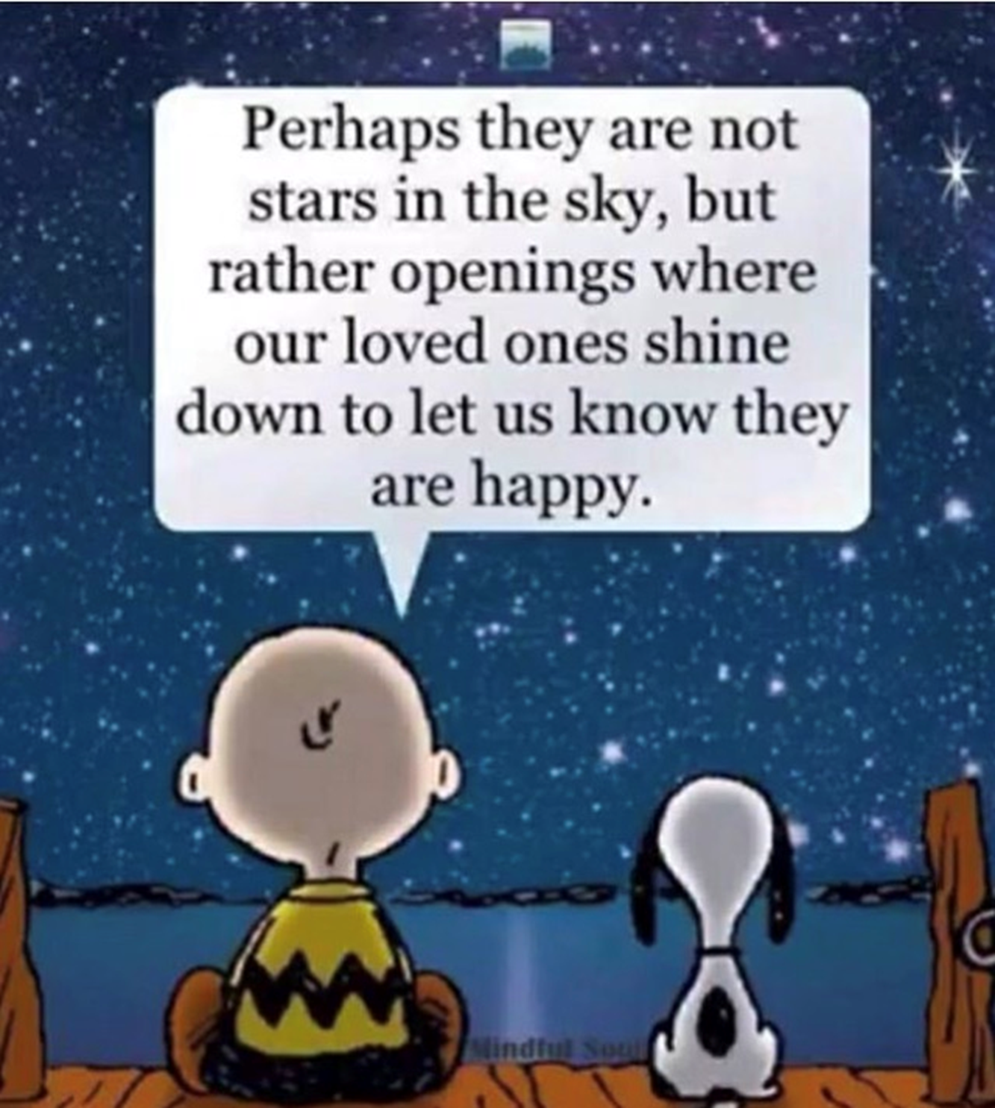

Slide 32
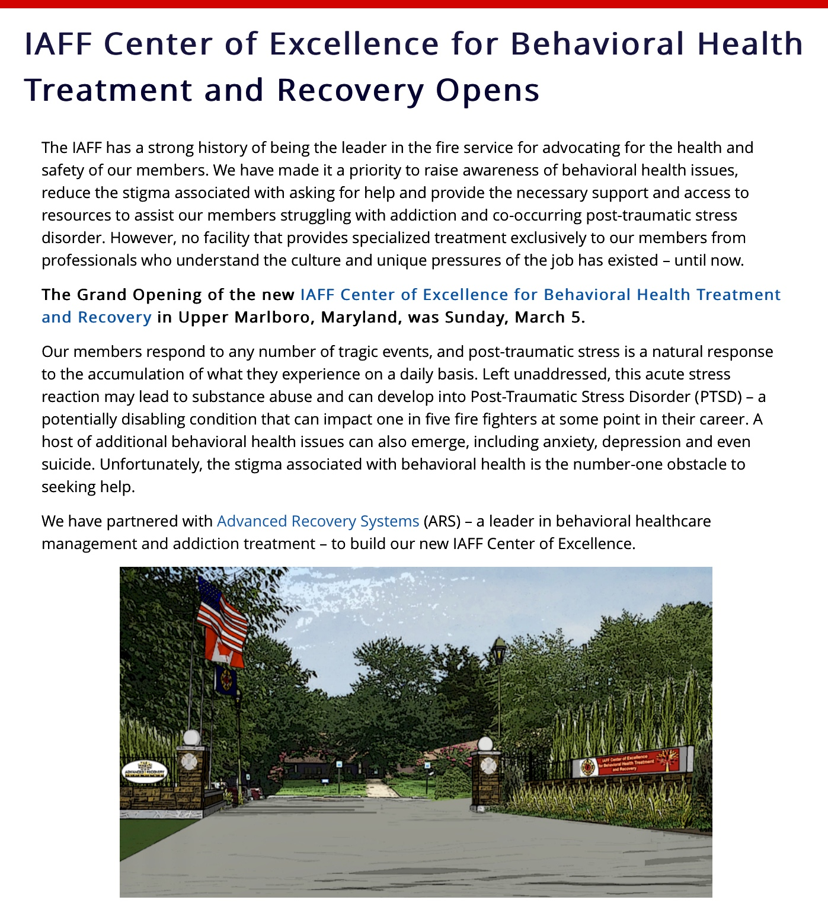
Other Resources
IAFF Behavioral Wellness Center
Notes:
How do we help the message stick?
“Stickiness means that the message has an impact.” (Gladwell, 2002)
Stickiness can be created by:
Communicating with emphasis
Communicating repeatedly
Communicating with the right people
Make message practical, personal, and memorable
Structure and format information to maximize stickiness
There is a simple way to packing information that, under the right circumstances, can make it irresistible. All you have to do is find it.” (Gladwell, 2002)

Slide 33
Resources
Notes:
How do we help the message stick?
“Stickiness means that the message has an impact.” (Gladwell, 2002)
Stickiness can be created by:
Communicating with emphasis
Communicating repeatedly
Communicating with the right people
Make message practical, personal, and memorable
Structure and format information to maximize stickiness
There is a simple way to packing information that, under the right circumstances, can make it irresistible. All you have to do is find it.” (Gladwell, 2002)
use of this website for reporting is “anonymous”

Slide 34
Other Resources
NFFF Fire Service Behavioral Health Management Guide
Training Resources - Hero Learning Network
Notes:
How do we help the message stick?
“Stickiness means that the message has an impact.” (Gladwell, 2002)
Stickiness can be created by:
Communicating with emphasis
Communicating repeatedly
Communicating with the right people
Make message practical, personal, and memorable
Structure and format information to maximize stickiness
There is a simple way to packing information that, under the right circumstances, can make it irresistible. All you have to do is find it.” (Gladwell, 2002)

Slide 35
Other Resources
National Volunteer Fire Council
Share the Load
Notes:
SHARE THE LOAD PROGRAM
ShareTheLoad_programs@2X
Share the Load™ Support Program for Fire and EMS
Most people are aware of the physical demands that first response activities place on firefighters and EMS providers. But it is important to also realize the impact that fighting fires and responding to emergencies has on the mental wellbeing of emergency personnel. Firefighters and EMS providers face the risk of many behavioral health concerns such as anxiety, depression, burnout, post-traumatic stress disorder, and addiction among others.
Taking care of your mental health is as important as managing your physical health. The NVFC’s Share the Load™ program provides access to critical resources and information to help first responders and their families manage and overcome personal and work-related problems. This includes the Fire/EMS Helpline, which offers free 24-hour assistance with issues such as stress, depression, addiction, PTSD, and more.
The resources in this section can assist individuals seeking help for a behavioral health issue as well as departments looking to implement or enhance a behavioral health program.
Fire/EMS Helpline – 1-888-731-FIRE (3473)
Share the Load™ Resources (Helpletter, poster, ads, family guide, suicide prevention report, training)
Share the Load Videos featuring warning signs to watch for, personal stories, how to talk to someone who needs help, and resources that are available.
Additional Fire Service and EMS Behavioral Health Resources (organizations, helplines, reports, courses and webinars)
Articles and news on behavioral health topics
National Fire Service Suicide Reporting System
We tragically lose dozens of firefighters and EMTs each year to suicide. The Firefighter Behavioral Health Alliance is the nationally recognized reporting system for collecting data about firefighter suicide. The reporting system is confidential and the data is used to identify trends and prevent future instances of firefighter and EMT suicide. To report a suicide, go to www.ffbha.org and click on “FF Suicide Report” in the left menu.

Slide 36
Closing
Feed yourself with positive, happy, me kind of thoughts.
YOU make a difference in my life and the life of all of those you touch.
Don’t forget to touch, love and smile.

Slide 37
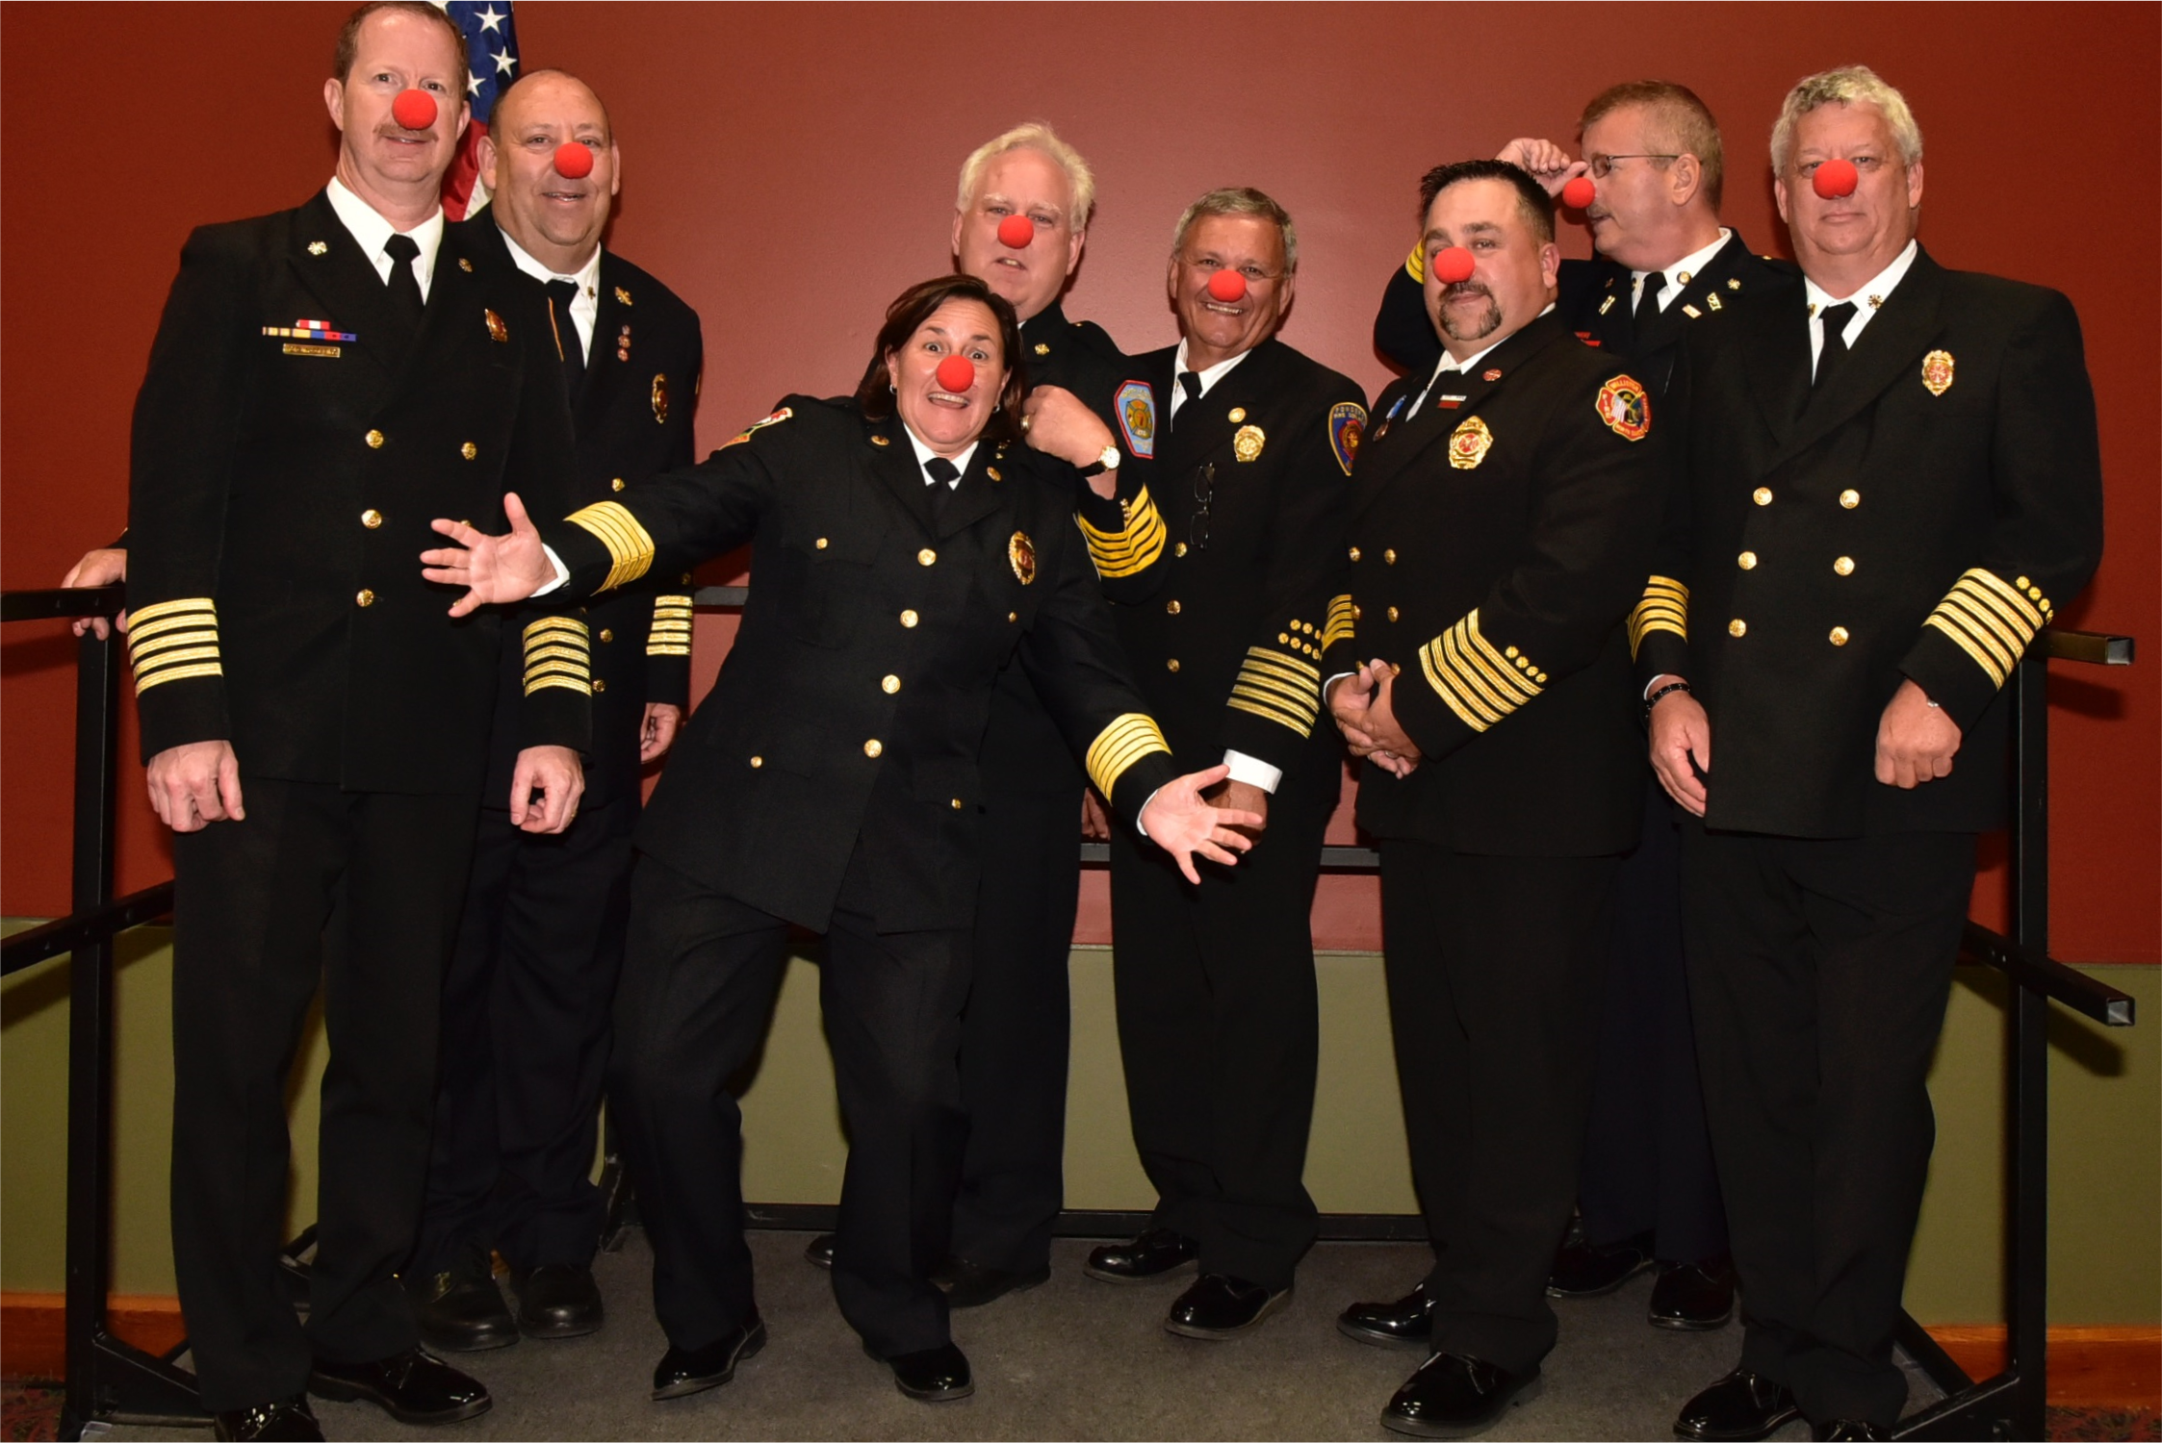
What You Feed Your Mind You Will Become?
Notes:
Instructor Note
True or False
Why?
The mind does not know the difference between right and wrong.
Your thoughts that enter your mind can poison your personality if you allow those thoughts to dominate your ind.
Page 21 Review the tips for dealing with stress write the words below on a easel pad or white board
Exercise
Respect your body
Breathe
Talk it out
Get control over your life
Practice mindfulness

Slide 38
Reading/Listening to Sustain Your Inner Joy
Zig Ziglar
Jeff Foxworthy
Denis Waitley
Bill Engvall
Larry the Cable Guy
C. W. Metcalf
Jim Gentil
Joel Osteen
Faith materials
Contact
John M. Buckman III
812-480-4339
johnmbuckmaniii@me.com
Notes:
Here's eight ways you can feed your brain and increase your intelligence.
1 Be curious. Instead of taking everything at face value, get into the habit of questioning everything. ...
2 Exercise regularly. ...
3 Do something new. ...
4 Train your memory. ...
5 Think positive. ...
6 Eat healthy. ...
7 Read a book. ...
8 8 Get enough sleep.

Slide 39
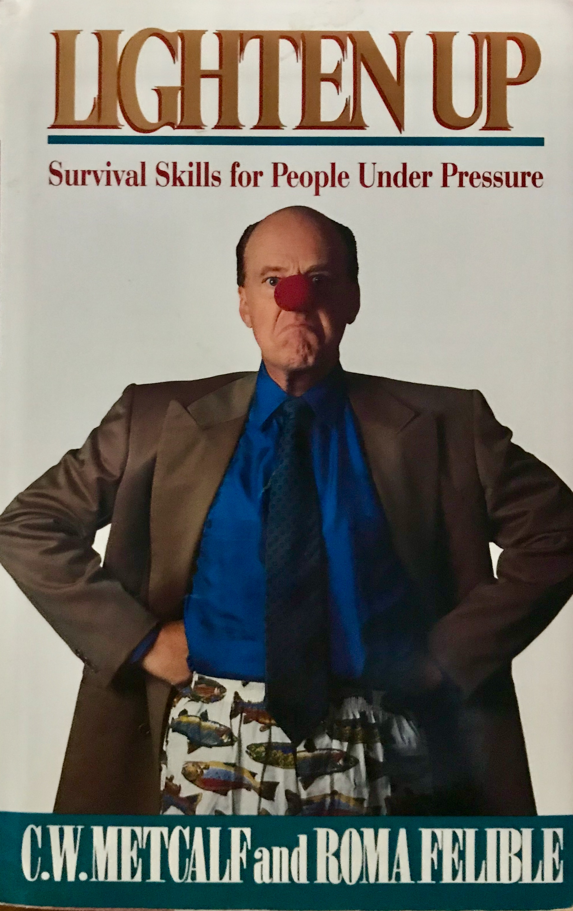

Slide 40
THE END

