Slide 1
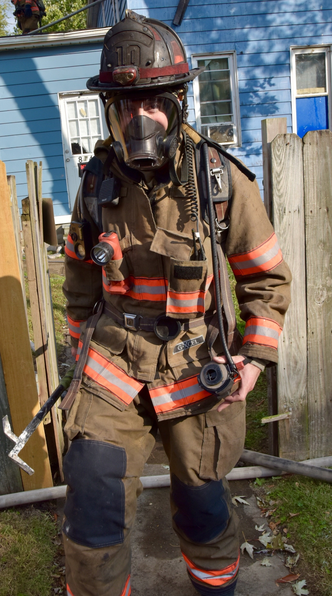
SURVIVING THE JOB
Notes:
It’s 2019 and the risk to firefighters health is increasing exponentionally daily. The chemical makeup of the material that is burning from inside is more deadly today than a short time ago. Will you survive the job? You can! You must be smarter and more aware of the risks associated with being a firefighter. It is not just fires. There are chemicals that are used in our daily lives that create additional risk to firefighters.

Slide 2
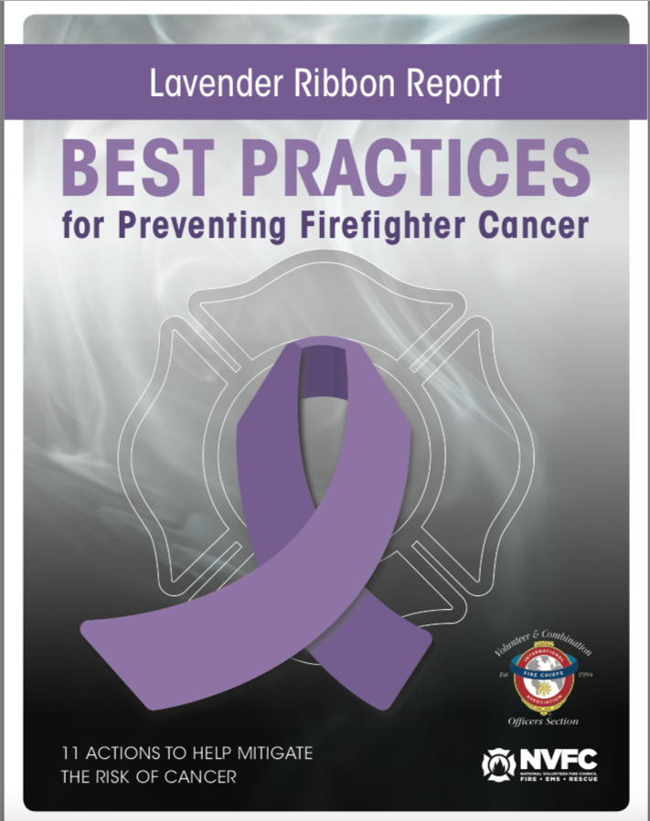

Slide 3
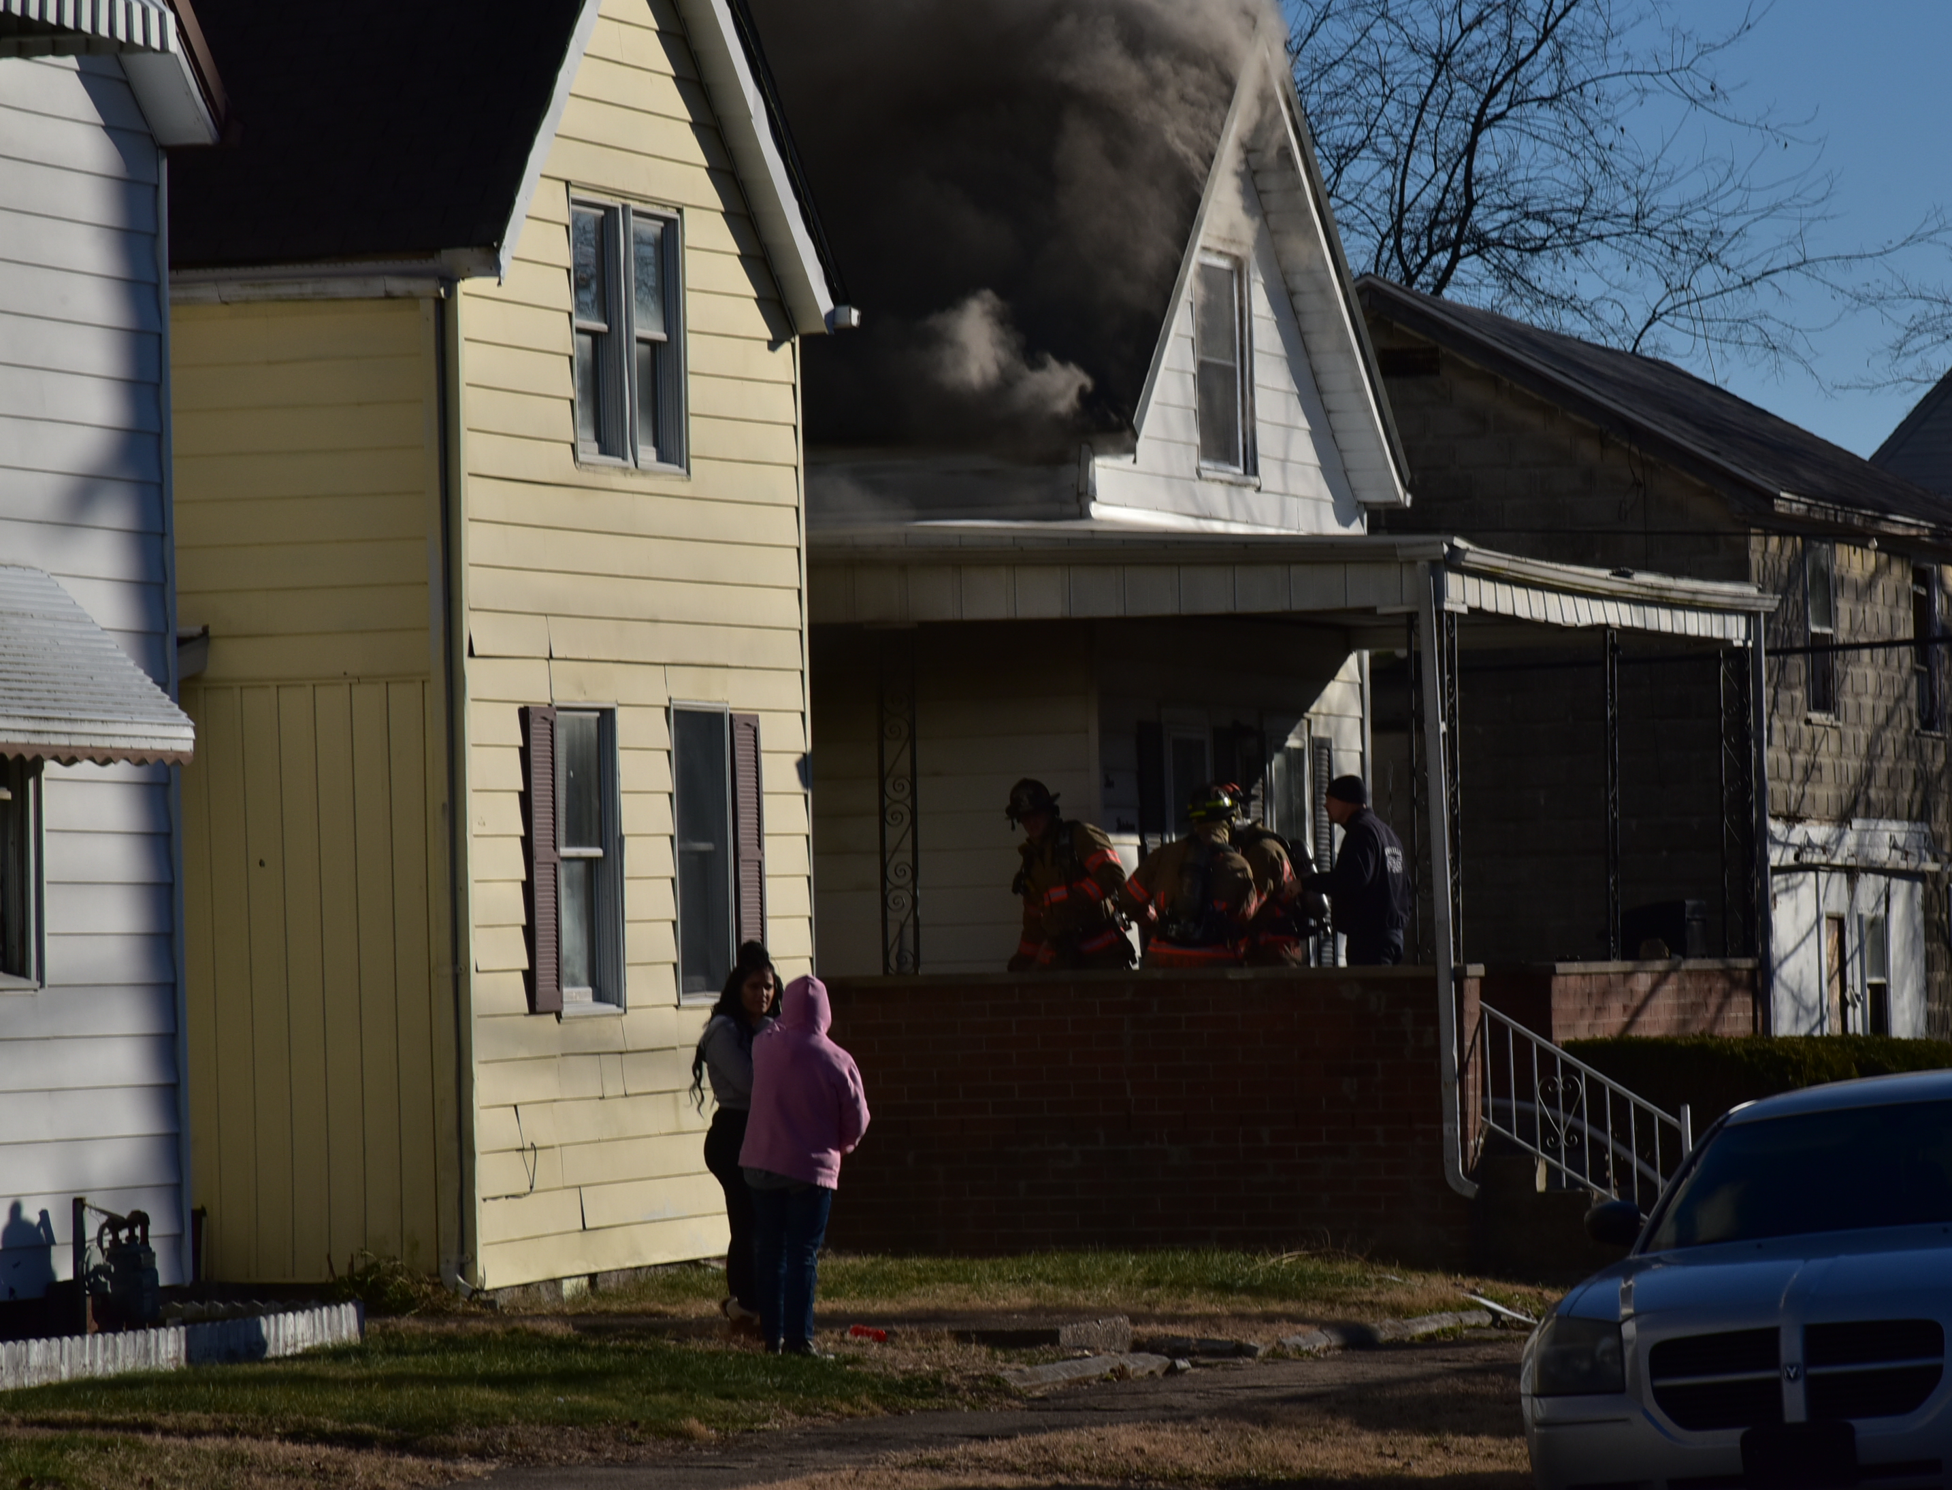

Slide 4
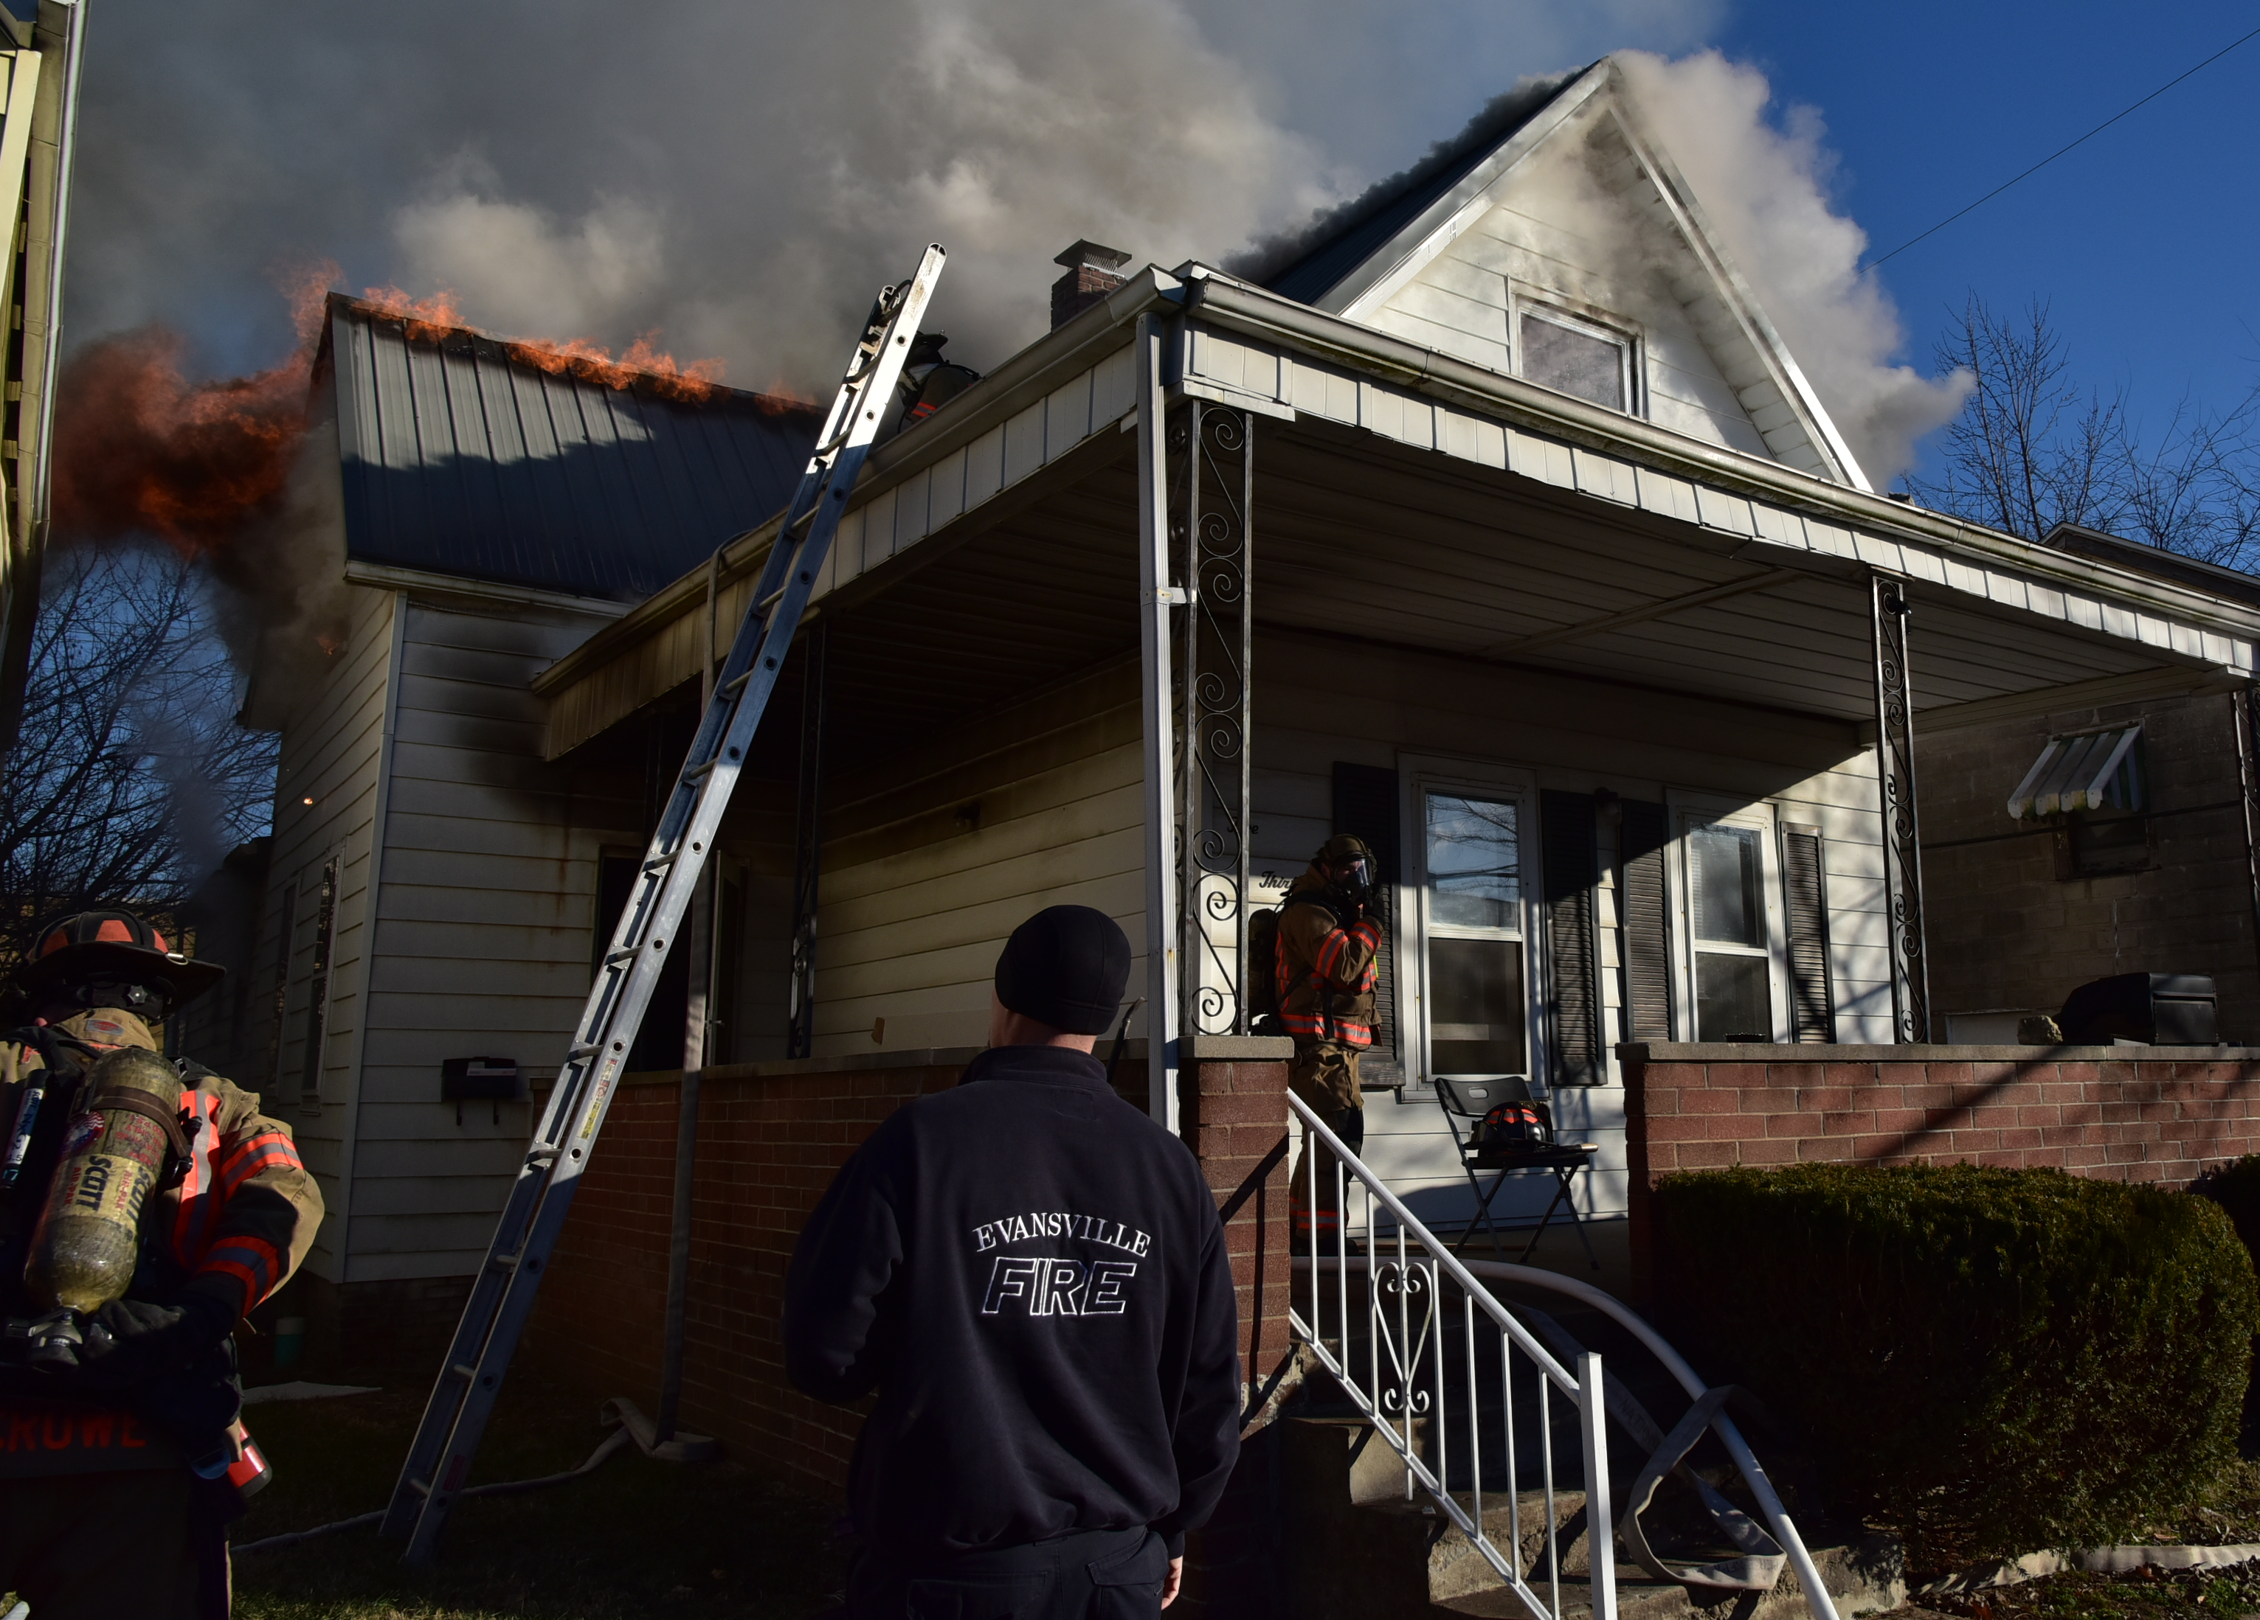

Slide 5
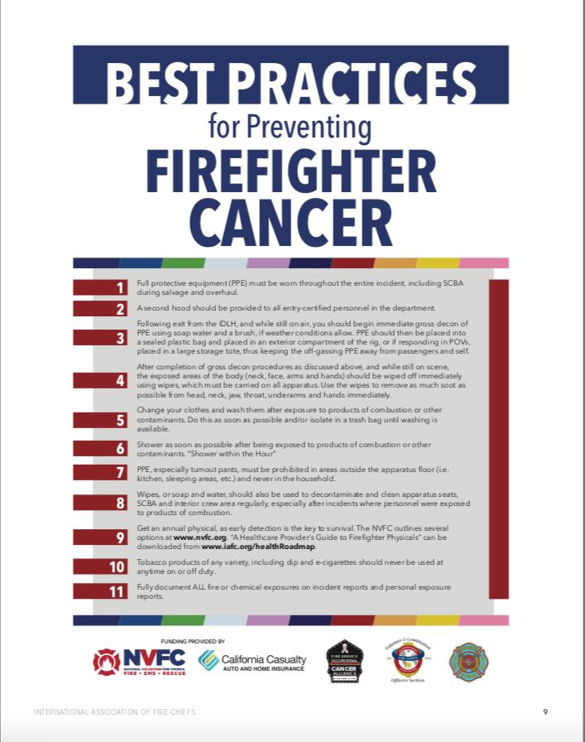

Slide 6
What do you do?
Multiple companies participated in a live burn training exercise at your training tower. Built in the Training was a Decon activity following the drill and prior to returning on the apparatus. You are the Safety Officer and see one of your Captains, Captain Gaffney refuses to Decon her gear. What will you do?

Slide 7
AC Massarotti requests that personal hoods be washed after all fires, fire training or monthly. You walk by Lieutenant Ryan’s gear as training is about to start. Lt. Ryan is a very good friend of yours and votes for you each year. His white hood is black from soot. Do you let it go?
What do you do?
POLITICS
OF SAFETY

Slide 8
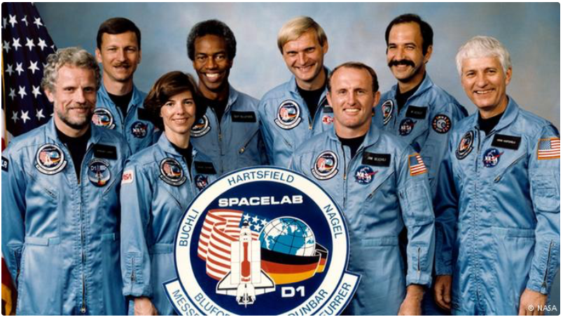
Normalization of Deviance!
Notes:
Bad actions don’t always come from poor procedures or inadequate training. Bad actions evolve naturally within companies/departments over time in many cases due to inadequate supervision. Many times normalization of deviance occurs without anyone noticing.
Normalization of deviance is a concept developed by the American sociologist Diane Vaughan.
She developed this theory when looking at where conflicts, mistakes, and disasters find their roots. She holds that the source of these phenomena lies in the environments in which they occur. Organizational factors are, for Vaughan, the key drivers behind moments where conflicts, mistakes, or disasters arise.
Cancer is a disaster to firefighters.
“Social normalization of deviance means that people within the organization become so much accustomed to a deviant behavior that they don’t consider it as deviant, despite the fact that they far exceed their own rules for the elementary safety”
Communications is the key to fighting deviance behavior.

Slide 11
Normalization of Deviance!
Not Wearing SCBA
What are fire service examples?
Ignore
Policy
Driving Speed
Empty Building
Behavior
Wellness
Not Wearing Gear
Notes:
Bad actions don’t always come from poor procedures or inadequate training. Bad actions evolve naturally within companies/departments over time in many cases due to inadequate supervision. Many times normalization of deviance occurs without anyone noticing.
Normalization of deviance is a concept developed by the American sociologist Diane Vaughan.
She developed this theory when looking at where conflicts, mistakes, and disasters find their roots. She holds that the source of these phenomena lies in the environments in which they occur. Organizational factors are, for Vaughan, the key drivers behind moments where conflicts, mistakes, or disasters arise.
Cancer is a disaster to firefighters.
“Social normalization of deviance means that people within the organization become so much accustomed to a deviant behavior that they don’t consider it as deviant, despite the fact that they far exceed their own rules for the elementary safety”
Communications is the key to fighting deviance behavior.

Slide 21
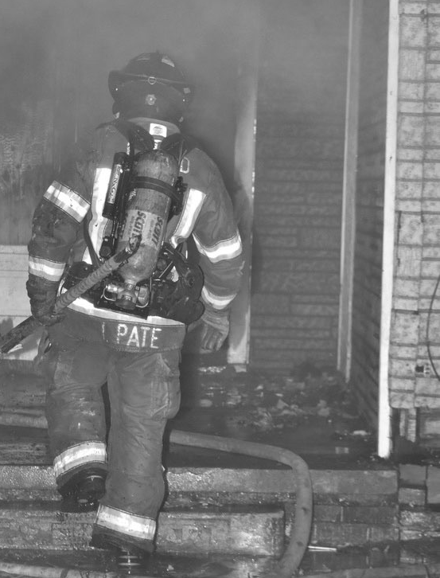
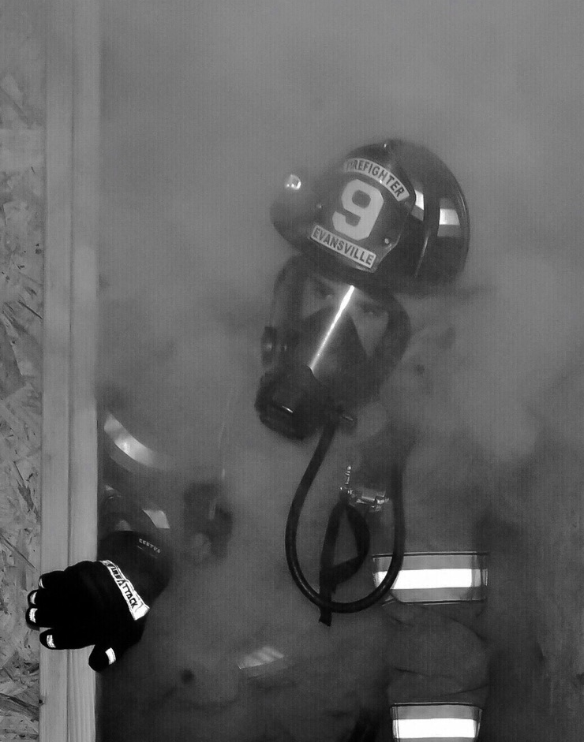
WHY?
Notes:
“Superman” Attitude
It won’t happen to me.
SCBA’s restrict me.

Slide 22
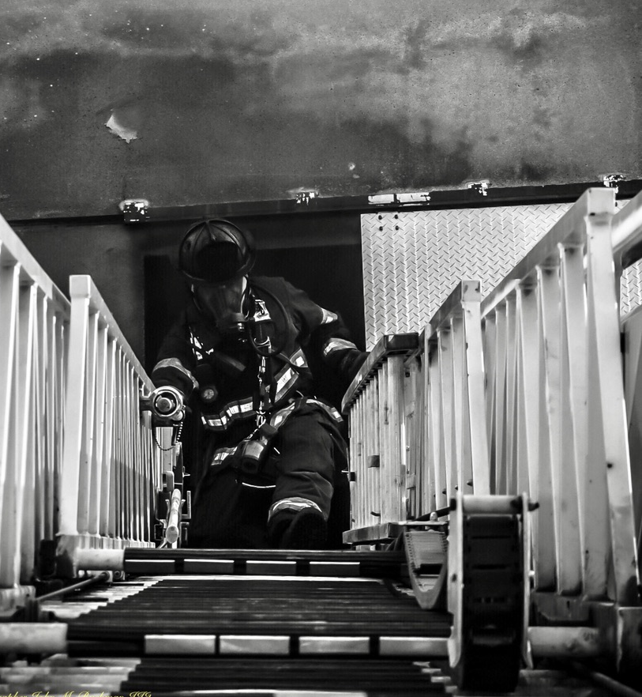
OUR WAY!
Notes:
Never had to do it that way before?
Gonna die from something.

Slide 23
Tipping Point
Book by Malcolm Gladwell
The Law of the Few!
The Stickiness Factor!
The Power of Context!
Notes:
Gladwell describes the "three rules of epidemics" (or the three "agents of change") in the tipping points of epidemics.
"The Law of the Few" is, as Gladwell states: "The success of any kind of social epidemic is heavily dependent on the involvement of people with a particular and rare set of social gifts”.
80/20 Principle, which is the idea that in any situation roughly 80 percent of the 'work' will be done by 20 percent of the participants”
The Stickiness Factor
The Stickiness Factor refers to the specific content of a message that renders its impact memorable. Popular children's television programs such as Sesame Street and Blue's Clues pioneered the properties of the stickiness factor, thus enhancing effective retention of educational content as well as entertainment value.
We can’t beat people over the head with cancer issues? We have to convince them that it is in their best interest to comply with policies and procedures.
The Power of Context
Human behavior is sensitive to and strongly influenced by its environment.
Certain types of people are key to the dissemination of information.

Slide 24
Tipping the Culture
Embracing Positive Change
Who needs to carry the message?
Family
The Chief
The Officers
The Firefighters
Others
Notes:
Without buy-in by the department the chances of emotional health being embraced as a necessary part of overall firefighter health are slim to none.
How do you get buy in?
One theory to Tip the Culture is to have message carriers.
Who needs to carry the message:
The Chief
The Officers
The Firefighters
All of the above

Slide 25
Cancer Reduction Sizeup
NEVER, EVEN LEAVE ANYONE BEHIND
Benchmarks
Recognition of actions not appropriate
Recognition of potential sign/symptoms
Annual physical
Cancer screening
Verify member has contacted doctor
Be open for/to follow-up
Risk Analysis
Family history
Busy Station/Company/Department
Stressors
Denial
Working at more than one fire department
Off-duty job
Resources
Peer support
Doctor visit
EAP
Incident Command Checklist
Open culture established
Wear SCBA
Decon after hot zone experience
Change street clothes quickly
Keep gear out of station
Stop all tobacco use
Decon apparatus
May Day
Recognition/Denial
SOP development
SOP compliance
Failure to reach out
Problem seen as not solvable
Nowhere to turn?
Notes:
Help you make the right decision
What are you evaluating
Resources
Benchmarks

Slide 26
Cancer Reduction Sizeup
NEVER, EVER LEAVE ANYONE BEHIND
Benchmarks
Recognition of actions not appropriate
Recognition of potential sign/symptoms
Annual physical
Cancer screening
Verify member has contacted doctor
Be open for/to follow-up
Risk Analysis
Family history
Busy Station/Company/Department
Stressors
Denial
Working at more than one fire department
Off-duty job
Resources
Peer support
Doctor visit
EAP
Incident Command Checklist
Open culture established
Wear SCBA
Decon after hot zone experience
Change street clothes quickly
Keep gear out of station
Stop all tobacco use
Decon apparatus
May Day
Recognition/Denial
SOP development
SOP compliance
Failure to reach out
Problem seen as not solvable
Nowhere to turn?
Notes:
Help you make the right decision
What are you evaluating
Resources
Benchmarks

Slide 27
Positive Discipline
Enforcement
Attitude
ZERO TOLERANCE
Policy Deviation
Communications
Collaboration

