Slide 1
Type Your Presentation Title Here
Place your full name with title here
Notes:
Place a title. Replace the VWS logo with your logo. You can also place an image of your department on this page. You can select a design by clicking on the design tab. This will show you a series of PowerPoint pre-designed tabs. We recommend you stick to a simple, clean and professional design.
To change the images:
Right click on the image
Place your cursor over Change Picture
Select From a File
Select your image from your files
Select Insert
To move an image:
Click and hold the image
Move the image to desired location
To resize an image:
Click the image
Place your cursor over the dots on the edge of the image
Click and drag to the desired size

Slide 2
Explain the above picture with a caption here
Notes:
Make sure to consider the following:
What does your Council know About the Fire Department?
How do they know it?
What are their expectations of their fire department?
Are they the same as the fire department’s?
Make sure you show them what you do – Don’t assume

Slide 3
Insert The Date of the Incident in the Photos
Notes:
Use this slide to add pictures of your department responding to an incident. Verbally explain the pictures to your leadership.

Slide 4
Insert Total Number of Incidents Here
Notes:
Data is important.
You are competing against other departments for funding and need to justify your request.
Because someone may die is not always effective. Everybody loves firefighters is not an effective justification.
To edit the chart:
Click on the Chart
Click on the darkened/highlighted Design at the top of the screen to the right of view
Select Edit Data
Make the appropriate changes
In some cases, you may need to move a data label or change the color or font.
To move a label:
Click the label
Click the label and Hold down the left mouse button
Drag label to desired location
Release the left mouse button
To edit all the labels:
Click the Graph
Click any data label (This should display a selected box around all of your data labels)
Make desired changes
To edit an individual label:
Click the graph
Click any data label (This should display a selected box around all of your data labels)
Click the desired data label (Now only this label should be selected)
Make desired changes

Slide 5
Incident Trends
(2007-2016)
Notes:
To edit the chart:
Click on the Chart
Click on the darkened/highlighted Design at the top of the screen to the right of view
Select Edit Data
Make the appropriate changes
In some cases, you may need to move a data label or change the color or font.
To move a label:
Click the label
Click the label and Hold down the left mouse button
Drag label to desired location
Release the left mouse button
To edit all the labels:
Click the Graph
Click any data label (This should display a selected box around all of your data labels)
Make desired changes
To edit an individual label:
Click the graph
Click any data label (This should display a selected box around all of your data labels)
Click the desired data label (Now only this label should be selected)
Make desired changes

Slide 6
Seasonal Call Volume
Notes:
To edit the chart:
Click on the Chart
Click on the darkened/highlighted Design at the top of the screen to the right of view
Select Edit Data
Make the appropriate changes
In some cases, you may need to move a data label or change the color or font.
To move a label:
Click the label
Click the label and Hold down the left mouse button
Drag label to desired location
Release the left mouse button
To edit all the labels:
Click the Graph
Click any data label (This should display a selected box around all of your data labels)
Make desired changes
To edit an individual label:
Click the graph
Click any data label (This should display a selected box around all of your data labels)
Click the desired data label (Now only this label should be selected)
Make desired changes

Slide 7
2016 Training
Total Training Hours: Insert Total Training Hours
Place Certifications Here
List What You Are Training For: MEDICAL, GAS LEAKS, GAS SPILLS, CAR WRECKS, ALARM ACTIVATIONS, STUCK IN ELEVATOR, LIGHTNING STRIKES, BRUSH FIRES, FIRES, WEATHER…
Notes:
Make sure to explain what you are training for, and why it is important to train as much as you do.

Slide 8
FY 2017 Budget
List What You Are Doing Within the Current Budget Here Ex:
MAINTAINING OPERATIONS WITHIN THE APPROVED BUDGET
CONTINUING TO PHASE EQUIPMENT PURCHASES AND REPLACEMENT WITHIN THE APPROVED CIP
Notes:
Make sure you tell them what you are not requesting

Slide 9
Insert Fire Department Name Here Personnel (Insert number of personnel)
Career Staff
Local Volunteers
Part-Time Firefighters
Non-Resident Standby
Notes:
In the Title, place your name and change the number to the total number of personnel the department has. If you don’t have a bubble, click the bubble and press the delete button. Click and drag the other bubbles to re-arrange accordingly. Make sure to include images of your personnel working and training.

Slide 10
Insert Fire Department Name Here Personnel
1 Chief
1 Deputy Chief
3 Full-Time Duty Officers
7 Part-Time Firefighters
14 Resident Volunteers
4 Non-Resident Volunteers
Notes:
Update the information to match your department. Add a photo of your personnel to make it more relatable.

Slide 11
Operational Expectation
EVERYTHING IS AN EMERGENCY UNTIL PROVEN OTHERWISE
People to respond
Timely response
Trained responders
List additional expectations

Slide 12
Challenge of Insert Your Fire Department Name
Type Your Goal Here Be Specific
Explain Why In 1 Sentence Here

Slide 13
Place Goal Here
Explain where your department is at currently, in relation to the goal. Remember data is your friend.

Slide 14
Insert Fire Department Name Trains to Respond To:
What We Respond To
What We Are Required To Respond To
List Everything You Respond to
"All-Hazards"
Medical Emergencies
Car Wrecks
Water Emergencies
Oil Spills
Gas Leaks
Fires
Fire Protection

Slide 15
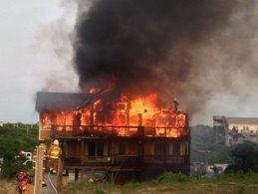
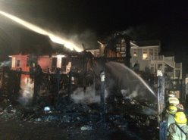
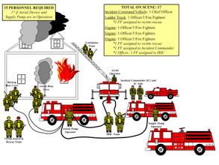
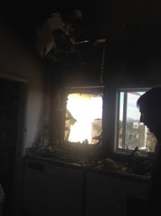
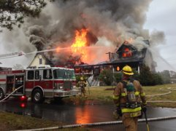
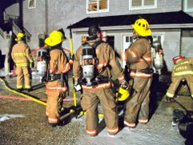
MUTUAL AID
Notes:
Place pictures on this slide with local fires. Explain that these incidents require mutual aid to safely and effectively be run.
To change the images:
Right click on the image
Place your cursor over Change Picture
Select From a File
Select your image from your files
Select Insert
To move an image:
Click and hold the image
Move the image to desired location
To resize an image:
Click the image
Place your cursor over the dots on the edge of the image
Click and drag to the desired size

Slide 16
NFPA 1710 Initial Full Alarm Assignment Deployed Within 8 Minutes
Notes:
Get Creative show them what your response ideally should be.

Slide 17
NFPA 1710 Initial Full Alarm Assignment Deployed Within 8 Minutes
Notes:
And what it is. Cover up the image by moving and tilting the white boxes on the above slide to show what you actually have on scene within 8 minutes. Explain why you have this and what their role is. (Make sure you remove the black outlines when you are done re-arranging.)
To move a white box:
Click and hold the image
Move the image to desired location
To resize an image:
Click the image
Place your cursor over the dots on the edge of the image
Click and drag to the desired size
To make another box:
Click a box
Press CTRL+C
Press CTRL+V
To delete a box:
Click the box
Press Delete
To remove the black outline:
Click the box
Click the darkened/highlighted tab labeled Format at the top of the screen
Click Shape Outline
Click No Outline

Slide 18
What has changed??
List Information on Why Things Have Changed
Lost {Insert Number} Volunteers
List why you lost the volunteers, ex. Moved, injured, etc.
Notes:
Justify What You Need
1. State the problem
2. Explain why
3. Anticipate questions/barriers
4. Provide supporting data

Slide 19
No longer able to MAINTAIN level of service that we have provided and town has been accustomed to.
How did we get here . . . ?

Slide 20
History
Insert Year Your Department Was Created | {Insert number} Members | {Insert Number} Calls
Insert Year | {Insert number} Members | {Insert Number} Calls
Insert Year | {Insert number} Members | {Insert Number} Calls
Insert Year | {Insert number} Members | {Insert Number} Calls
Notes:
Choose 4 to 5 Key Historical points to demonstrate how your department has changed. Make sure you explain the importance of each year.
Recommended Years:
Year the Department was Founded
Year the Department received first paid member

Slide 21
Constantly Changing
List what you have done to meet community demands/needs
Notes:
Highlight the changes you have made to ensure your department is effective. This may include transitioning to a combination department to ensure fulltime coverage, or it could be additional fundraisers to pay for equipment or training yourselves, it also could be a review of grants you have applied for.

Slide 22
Personnel on First Out Apparatus
Notes:
To edit the chart:
Click on the Chart
Click on the darkened/highlighted Design at the top of the screen to the right of view
Select Edit Data
Make the appropriate changes
In some cases, you may need to move a data label or change the color or font.
To move a label:
Click the label
Click the label and Hold down the left mouse button
Drag label to desired location
Release the left mouse button

Slide 23
Volunteer FF/In-Town Suppression FF (2006-2016)
Notes:
You can change the bar graph to compare anything you would like. You want to show in multiple ways the situation of your fire department. The goal of this slide is to show numbers are decreasing across the board.
To edit the chart:
Click on the Chart
Click on the darkened/highlighted Design at the top of the screen to the right of view
Select Edit Data
Make the appropriate changes
In some cases, you may need to move a data label or change the color or font.
To move a label:
Click the label
Click the label and Hold down the left mouse button
Drag label to desired location
Release the left mouse button

Slide 24
Members and Incident Trends (2006-2016)
Notes:
Explain that you are showing that you are running more calls with less people.
To edit the chart:
Click on the Chart
Click on the darkened/highlighted Design at the top of the screen to the right of view
Select Edit Data
Make the appropriate changes
In some cases, you may need to move a data label or change the color or font.
To move a label:
Click the label
Click the label and Hold down the left mouse button
Drag label to desired location
Release the left mouse button

Slide 25
“We'll Go Get Some Volunteers”
Notes:
Anticipate your leadership's reaction and prepare for it.
Change the above text to meet your needs. If you are asking for equipment, replace it with "We'll Increase Our Fundraising Efforts"

Slide 26
Value of Volunteers
$1,204,500
$3,300
$1,100
All approximate values to nearest $100.
Based on national average of $22 per hour for paid firefighter position.
Per NFPA 1720:
​Minimum personnel needed to respond to a fire incident in a ​
rural area is 6.​
​
Engine staffed by four personnel for 12 hour shift
Three minimally staffed engines for 12 hour shift
Three minimally staffed engines, 12 hour shifts, 365 days
Notes:
Explain the cost that your department is saving the leadership by utilizing volunteers where possible, and that you understand the importance of saving money.

Slide 27
Volunteer Recruitment
List why you are struggling to get more volunteers/ or why your internal efforts are not enough to solve the problem
Point out your key reasons why it is a struggle. In the case of volunteers, it could be the following:
DESIRE TO RUN INTO A BURNING BUILDING, RESPOND IN THE MIDDLE OF THE NIGHT TO NOTHING, STAND AND DIRECT TRAFFIC OR HELP PATIENTS AND SECURE A VEHICLE AT A CAR WRECK IN THE MIDDLE OF THE SUMMER, LEAVE THE DINNER TABLE , MISS THE BIRTHDAY…………

Slide 28
Us Compared to Others
Type Your Department Name Here | Type Neighboring Department Name Here | Type Neighboring Department Name Here | Type Neighboring Department Name Here | Type Neighboring Department Name Here
Type Your Population # Here | Type Their Population # Here | Type Their Population # Here | Type Their Population # Here | Type Their Population # Here
Type Your Member Count Here | Type Their Member Count Here | Type Their Member Count Here | Type Their Member Count Here | Type Their Member Count Here
Place the percentage of members to the population here | Place the percentage of members to the population here | Place the percentage of members to the population here | Place the percentage of members to the population here | Place the percentage of members to the population here
Notes:
Show how your department compares to others using statistics. This should display that you are doing your best within your ability but it is still not enough.
The formula for the last row is
(Number of Members/Number of Population)x100= The percentage of population that are members.

Slide 29
Emerging Issues
List the issues that are beginning now and verbally discuss how granting your request will allow you to solve them.

Slide 30
Other Perspectives
Insert Name
Insert Name
Insert Name
Insert title of individual as well as relationship with the department
Insert title of individual as well as role within the department
Insert title of individual as well as relationship with the department
Notes:
Bringing in other voices can help you make your point to the leadership.
We recommend you bring in:
1. Firefighters
2. Citizens
3. Third parties

Slide 31
Current Situation
List how things are currently within the department and explain clearly why this isn't working
Explain what the situation will be like, if you are granted your request.

Slide 32
Total Calls/EMS/Career + PT Staff (No Chiefs)
Type Your Department Name Here | Type Neighboring Department Name Here | Type Neighboring Department Name Here | Type Neighboring Department Name Here | Type Neighboring Department Name Here
Type Your # of Calls | Type Their # of Calls | Type Their # of Calls | Type Their # of Calls | Type Their # of Calls
Type Your # of EMS Calls | Type Their # of EMS Calls | Type Their # of EMS Calls | Type Their # of EMS Calls | Type Their # of EMS Calls
[Type # of Career] + [Type # of Part Time Staff] | [Type # of Career] + [Type # of Part Time Staff] | [Type # of Career] + [Type # of Part Time Staff] | [Type # of Career] + [Type # of Part Time Staff] | [Type # of Career] + [Type # of Part Time Staff]
Type # of Paid Firefighters on Duty at all times | Type # of Paid Firefighters on Duty at all times | Type # of Paid Firefighters on Duty at all times | Type # of Paid Firefighters on Duty at all times | Type # of Paid Firefighters on Duty at all times
Notes:
Change the chart accordingly
Demonstrate how your situation compares to departments near you.

Slide 33
Insert What You Are Asking For Here In Specific Clear Text

Slide 34
What This Will Look Like
List all of the benefits the department will receive if you are given what you are asking for

Slide 35
Implementation
List how you will implement this if granted.

Slide 36
VOLUNTEERS ARE AGING PUTTING SUPPORT FIREFIGHTERS IN SUPPRESSION SITUATIONS NOT TRYING TO STAFF FOR WORST-CASE SCENARIO BUT FOR THE EVERYDAY OPERATIONS AND RESPONSE
2017 Reality
Notes:
Explain the reality of your request and how it is reasonable and necessary to be able to do your job daily.

Slide 37
Age of Top 10 Volunteer Responders (2017)
Notes:
Place the ages of your top 10 responders above to demonstrate the age of your volunteers. Place X’s on the volunteers that are will be leaving soon. Make red the ones that are NOT interior firefighters.
To edit the chart:
Click on the Chart
Click on the darkened/highlighted Design at the top of the screen to the right of view
Select Edit Data
Make the appropriate changes
In some cases, you may need to move an X.
To move an X:
Click and Hold the X down with the left mouse button
Drag the X to desired location
Release the left mouse button
To make another X:
Click the X
Press CTRL+C
Press CTRL+V
To delete an X:
Click the X
Press Delete
To change the color of the bar:
Click on the desired bar, this will select all of the bars
Click on the desired bar again to select only that bar
Select the darkened/highlighted Format tab at the top of your screen
Select the button labeled Shape Fill
Select the desired color

Slide 38
Incidents by Day of Week (%) 2011-2016 Average
Notes:
The above graph shows the breakdown of incidents by day of week in percentages.
To edit the chart:
Click on the Chart
Click on the darkened/highlighted Design at the top of the screen to the right of view
Select Edit Data
Make the appropriate changes

Slide 39
Percent of Incidents by Time of Day (2011-2016)
68%
Notes:
In the above graph, show your leadership, when you are receiving calls throughout the day. Make your peak time period stand out by changing those bars to red. Let them know what the red area constitutes, by adding up all of the red bars, and placing their total where it says 68%.
To edit the chart:
Click on the Chart
Click on the darkened/highlighted Design at the top of the screen to the right of view
Select Edit Data
Make the appropriate changes
To change the color of the bar:
Click on the desired bar, this will select all of the bars
Click on the desired bar again to select only that bar
Select the shaded Format tab at the top of your screen
Select the button labeled Shape Fill
Select the desired color
To edit the total percentage of your peak incident times:
Click the 68%
Make the necessary changes

Slide 40
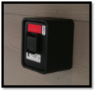
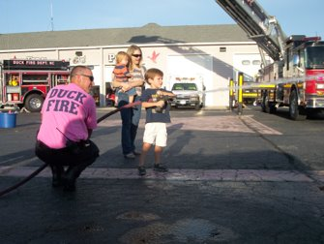
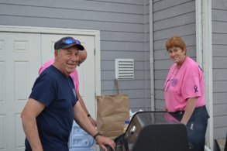
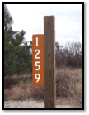
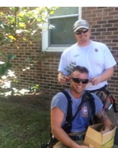
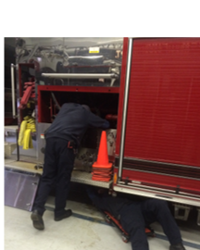
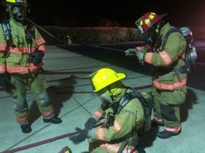
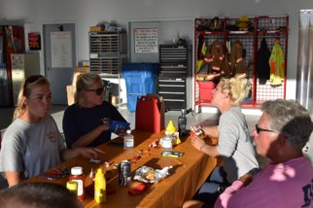
Our Volunteers Hard At Work
Notes:
Put a Face to the Problem. Show that you are out working hard and being a member of the community. Replace the above images with your images from trainings, community events and fundraising.
To change the images:
Right click on the image
Place your cursor over Change Picture
Select From a File
Select your image from your files
Select Insert
To move an image:
Click and hold the image
Move the image to desired location
Release the left mouse button
To resize an image:
Click the image
Place your cursor over the dots on the edge of the image
Click and drag to the desired size
Release the left mouse button

Slide 41
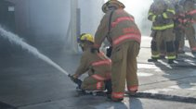
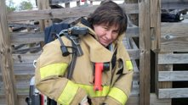
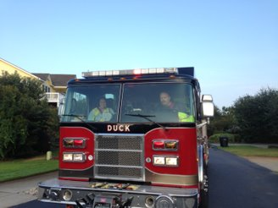
Insert Your Fire Department Name is Flexible and Has Adapted to Response Changes
Notes:
Replace the above images with your own.
To change the images:
Right click on the image
Place your cursor over Change Picture
Select From a File
Select your image from your files
Select Insert
To move an image:
Click and hold the image
Move the image to desired location
Release the left mouse button
To resize an image:
Click the image
Place your cursor over the dots on the edge of the image
Click and drag to the desired size
Release the left mouse button
.

Slide 42
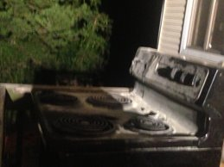
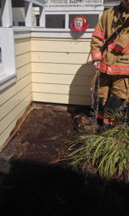
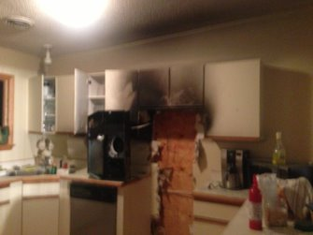
Minimize Damage Small Kitchen Fire Small Brush Fire
Our Goal
Notes:
Explain your goal is to keep fires small when you have one, and that granting you what you are asking for will help you keep them small. Replace slide images with images of fires that your department kept small.
To change the images:
Right click on the image
Place your cursor over Change Picture
Select From a File
Select your image from your files
Select Insert
To move an image:
Click and hold the image
Move the image to desired location
Release the left mouse button
To resize an image:
Click the image
Place your cursor over the dots on the edge of the image
Click and drag to the desired size
Release the left mouse button

Slide 43
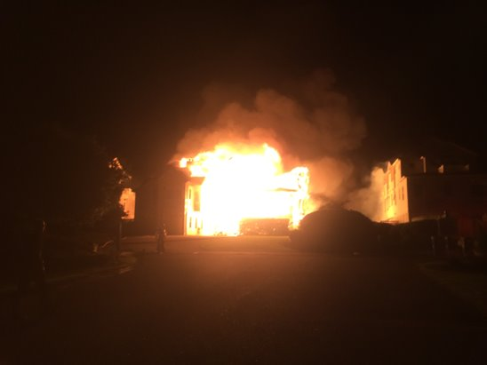
Staff for the Small Events in Hopes to Prevent the Worst Case Scenario
Notes:
Explain that them granting you your request will hopefully allow you to prevent the worst case scenarios from happening by improving your abilities.

Slide 44
Core Vision
Insert Your Leadership's Core Vision Here
Notes:
How does your fire department fit in with other services?
Layout the Core Vision of the leadership.

Slide 45
Core Vision
List How Your Department Connects with the Core Vision of your leadership
Notes:
Explain how you are a part of the core vision of the leadership and them granting your request will allow you to continue to be a part of the core vision.

Slide 46
On The Bright Side
List some positives about your department and the community
Notes:
Always End With The Positive

Slide 47
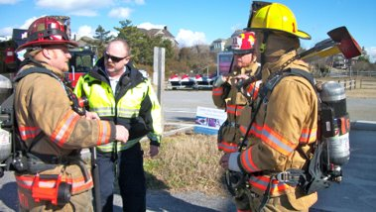
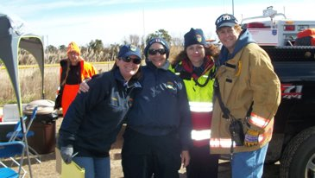
Insert Fire Department Name is Here to Serve The Community.
My Job, With Your Help, is to Protect the Insert Fire Department Name Firefighters
Please Consider Insert Request
Notes:
Replace above images with your firefighters.

Slide 48
Thank You & Questions
Notes:
Add a Final Picture

